Slide 1
Understanding Your Software Development (through git repository data mining and code analysis)
Boyana R. Norris
(she/her)
University of Oregon
Software Productivity and Sustainability track @ Argonne Training Program on Extreme-Scale Computing summer school
Contributors: Stephen Fickas (UO), Bosco Ndemeye (UO), Boyana R. Norris (UO), Jason Prideaux (UO)
https://github.com/CAT-SDK/GremCat

Slide 2
License, Citation and Acknowledgements
License and Citation
This work is licensed under a Creative Commons Attribution 4.0 International License (CC BY 4.0).
The requested citation the overall tutorial is: David E. Bernholdt, Anshu Dubey, Todd Gamblin, Jared O’Neal, and Boyana R. Norris, Software Productivity and Sustainability track, in Argonne Training Program on Extreme-Scale Computing, St. Charles, Illinois, 2022. DOI: 10.6084/m9.figshare.20416215.
Individual modules may be cited as Speaker, Module Title, in Better Scientific Software tutorial, ISC, 2022 …
Acknowledgements
This work was supported by the U.S. Department of Energy Office of Science, Office of Advanced Scientific Computing Research (ASCR), and by the Exascale Computing Project (17-SC-20-SC), a collaborative effort of the U.S. Department of Energy Office of Science and the National Nuclear Security Administration.
This work was performed in part at the Argonne National Laboratory, which is managed by UChicago Argonne, LLC for the U.S. Department of Energy under Contract No. DE-AC02-06CH11357.
This work was performed in part at the Lawrence Livermore National Laboratory, which is managed by Lawrence Livermore National Security, LLC for the U.S. Department of Energy under Contract No. DE-AC52-07NA27344.
This work was performed in part at the Los Alamos National Laboratory, which is managed by Triad National Security, LLC for the U.S. Department of Energy under Contract No.89233218CNA000001
This work was performed in part at the Oak Ridge National Laboratory, which is managed by UT-Battelle, LLC for the U.S. Department of Energy under Contract No. DE-AC05-00OR22725.
This work was performed in part at Sandia National Laboratories. Sandia National Laboratories is a multi-mission laboratory managed and operated by National Technology and Engineering Solutions of Sandia, LLC., a wholly owned subsidiary of Honeywell International, Inc., for the U.S. Department of Energy’s National Nuclear Security Administration under contract DE-NA0003525.
This work was performed in part at University of Oregon through a subcontract with Argonne National Laboratory.

Slide 3
Motivation
Software development productivity is affected by many factors, many of which are difficult or impossible to measure (accurately).
So far in this track, the focus was on concepts and best practices based on research, experience and expert opinion.
Here, we focus on supporting best practices through software tools that can help understand how existing or new software practices may affect these observables.
Tools are meant to be used -- so we will show some simple ways in which anyone can begin exploring their own project’s data without significant up-front investment of time and effort.

Slide 4
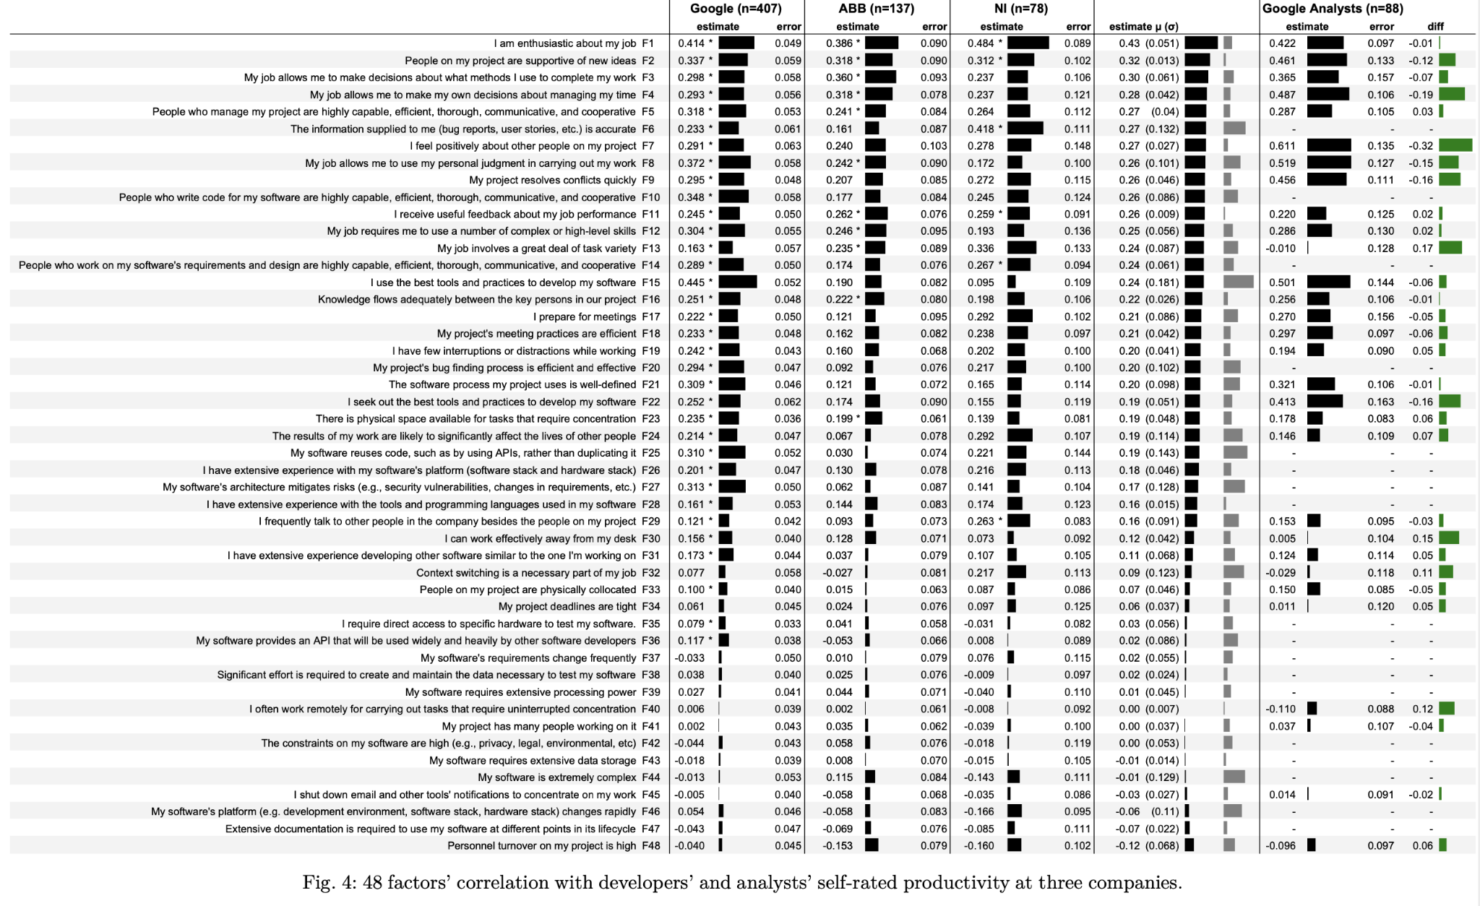
Motivation
(Am I just making things up?)
Murphy-Hill, E., Ciera Jaspan, Caitlin Sadowski, D. Shepherd, Michael Phillips, C. Winter, Andrea Knight, Edward K. Smith and M. Jorde. “What Predicts Software Developers’ Productivity?” IEEE Transactions on Software Engineering 47 (2021): 582-594.
Top three (on average):
• Job enthusiasm (F1)
• Peer support for new ideas (F2)
• Useful feedback about job performance (F11)
Top factor at Google!

Slide 5
Other software-related factors
Murphy-Hill, E., Ciera Jaspan, Caitlin Sadowski, D. Shepherd, Michael Phillips, C. Winter, Andrea Knight, Edward K. Smith and M. Jorde. “What Predicts Software Developers’ Productivity?” IEEE Transactions on Software Engineering 47 (2021): 582-594.
A few other positively rated software-related factors (in decreasing order of average scores):
My project’s bug finding process is efficient and effective.
The software process my project uses is well defined.
My software reuses code, such as by using APIs, rather than duplicating it.
My software’s architecture mitigates risks (e.g., security vulnerability, changes in requirements, etc.).
Negative impact on productivity:
My software requires extensive data storage.
My software is extremely complex.
My software's platform (e.g. development environment, software stack, hardware stack) changes rapidly.
Extensive documentation is required to use my software at different points in its lifecycle.

Slide 6
Murphy-Hill et al. study conclusions
“A notable outcome of the ranking is that the top 10 productivity factors are non-technical. This is somewhat surprising, given that most software engineering research tends to focus on technical aspects of software engineering, in our estimation.
Thus, a vigorous refocusing on human factors may yield substantially more industry impact for the software engineering research community. For instance, answering the following questions may be especially fruitful:
What makes software developers enthusiastic about their job? What accounts for differences in levels of enthusiasm between developers? What interventions can increase enthusiasm? This work can extend existing work on developer happiness [24] and motivation [25].
What kinds of new ideas are commonly expressed in software development practice? What actions influence developers’ feelings of support for those ideas? What interventions can increase support for new ideas, while maintaining current commitments?
What kinds of job feedback do software engineers receive, and what makes it useful? What kinds of feedback is not useful? What interventions can increase the regularity and usefulness of feedback?” [emphases mine]

Slide 7
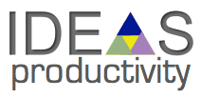


What we are trying to do
This work is part of two DOE ECP projects:
IDEAS-ECP: foster and promote SE practices for better software
xSDK: Extreme-scale Scientific Software Development Kit
Motivation and enthusiasm are ephemeral things that cannot be quantified easily.
On the other hand, we have many artifacts and associated metadata that are related (if indirectly) to productivity.
More and better software
So, we are betting that using some data is better than not looking at any data, as we make decisions that are aimed at improving software development productivity and code quality.
Enthusiasm, motivation
Development-related data and analysis

Slide 8
What this module is about
We introduce a flexible,
efficient, and
usable software framework for acquiring,
storing,
manipulating, and
visualizing
development-related data.
We demonstrate a few of its capabilities here; we continue to add new patterns and tools.
Contributions welcome! github.com/CAT-SDK/GremCat/
ECP projects that may be present in examples in this module: Spack, LAMMPS, PETSc, Nek5000 E3SM, QMCPACK, QDPXX, LATTE NAMD, fast-export, Enzo, TAU2, xpress-apex, LATTE, NWChem, FLASH, Gingko.

Slide 9
Part I: Mining development metadata
Part II: Analyzing code

Slide 10
Part I: Mining your development data
Development data:
Git metadata: commits, forks, branches, developers
Issues and associated discussions
Pull requests (github, gitlab) and associated discussions
Mailing list archives
Goal: Analyze available data to help formulate and answer questions about development processes and their impact on productivity and code quality.

Slide 11
Questions that can be answered (in part) with IDEAS data analysis tools
If I adopt practice X, how will metric Y be affected?
How active is the developer community? (git, issues, PRs, emails)
What parts of the code base could benefit from review or refactoring? (git, issues)
What is the project’s reliance on individual developers? (git)
How are developers’ contributions split among different categories? (git, manual labeling required)
How engaged are the user and developer communities? (PRs, issues, mailing lists)
What are some hot topics of discussion? (issues, mailing lists)
How and on what do developers collaborate? (git, issues, mailing lists)
….

Slide 12
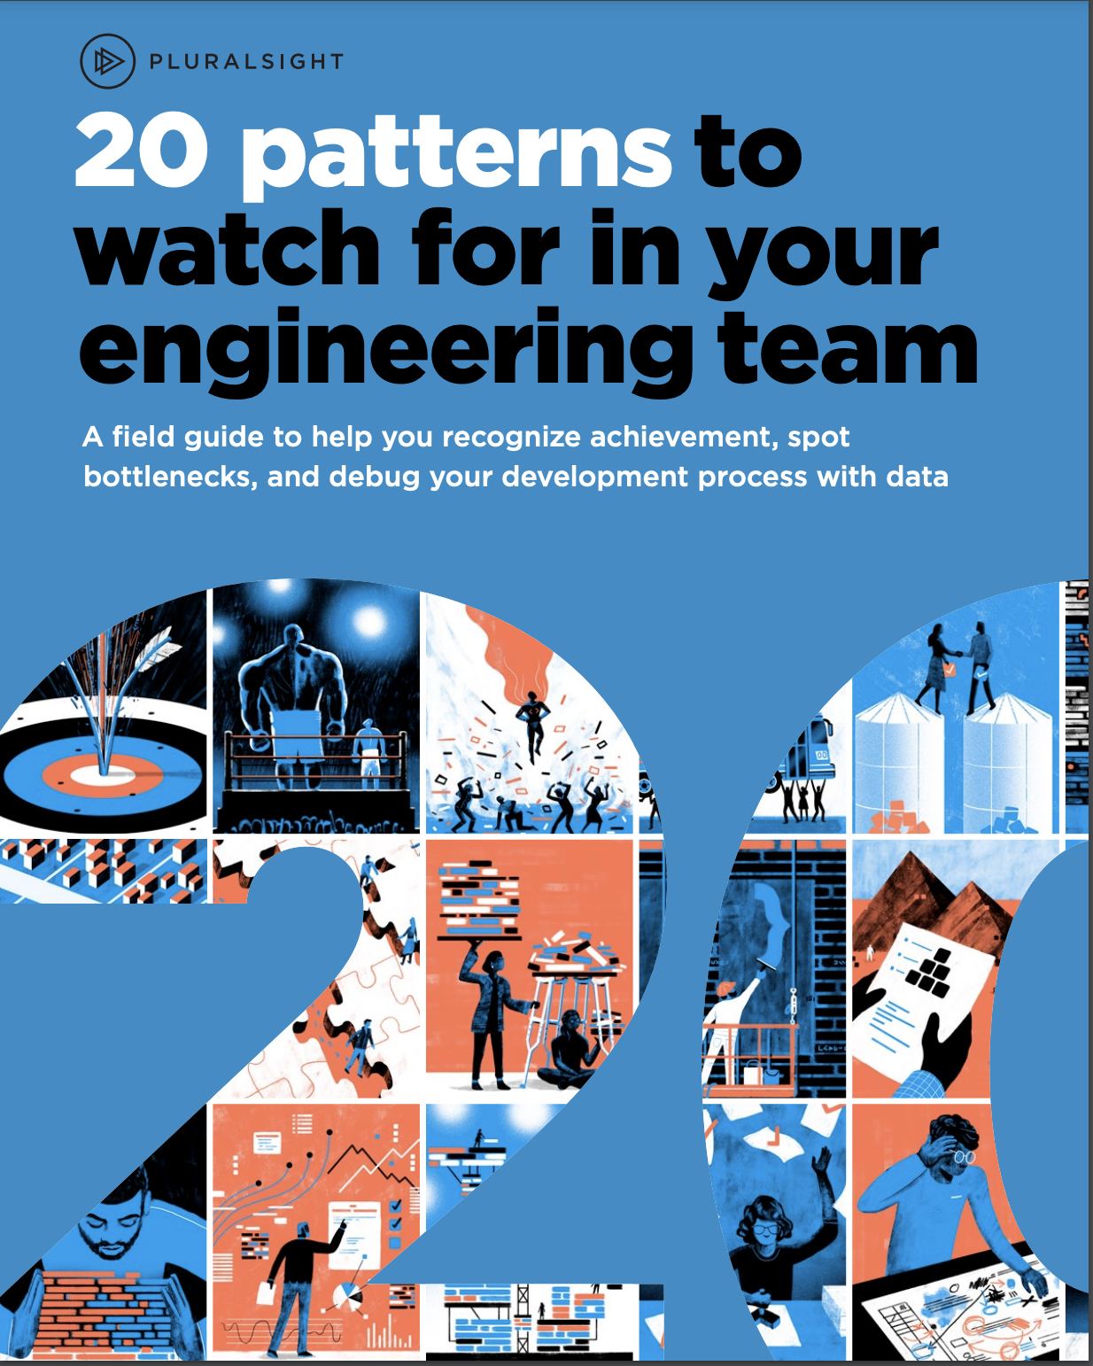
Common patterns with known implications
Pluralsight book (2019)¹:
“20 patterns is a collection of work patterns we’ve observed in working with hundreds of software teams. Our hope is that you’ll use this field guide to get a better feel for how the team works, and to recognize achievement, spot bottlenecks, and debug your development process with data.”
¹https://www.pluralsight.com/content/dam/pluralsight2/landing-pages/offers/flow/pdf/Pluralsight_20Patterns_ebook.pdf

Slide 13
Common patterns with known implications
Starting with these pattern descriptions, we can:
Identify patterns that are relevant to HPC (open-source) software development.
Characterize each pattern using data from revision control systems and developer communications.
Inform decisions of the effects of adopting new SE practices.
¹https://www.pluralsight.com/content/dam/pluralsight2/landing-pages/offers/flow/pdf/Pluralsight_20Patterns_ebook.pdf

Slide 14
Example metrics
Metric | Description
Monthly bug fix rate | Computes cumulative count of bugs closed each month, starting from the beginning of the project. A higher value is not necessarily good, trends are more informative than individual values.
Monthly feature request rate | Number of new feature requests made by users. A higher value may indicate popularity/importance of the feature or missing functionality in the current software version.
Correlation of the number of issues with project age | Gives a good insight into the life cycle of the project by mapping the trend of issues raised over the lifetime of the project.
Commits, derived metrics | Characterizes some aspects of developer activity.
Number of issues | Project-related communications can be used to indicate community involvement and rates at which issues are resolved. For example, fast-growing projects can have significantly more activity in issues than more mature ones.
Issue categories | Identifies the types of issues that are reported in the repository. This information will be useful to derive correlation with other metrics.
Number of followers and watchers | Reports the code maturity and popularity. In addition, the number of followers can be correlated with the time it takes to fix reported issues.
Mailing list metrics | Relates to average time in discussion, most popular topic of interest, product activity based on type of emails, etc.
Number of contributors | Size of development community. When analyzed over time, we can estimate project turnover and identify different types of contributors.
Code complexity | Compute changes to code complexity metrics, e.g., cumulative size or cyclomatic complexity, over time.

Slide 15
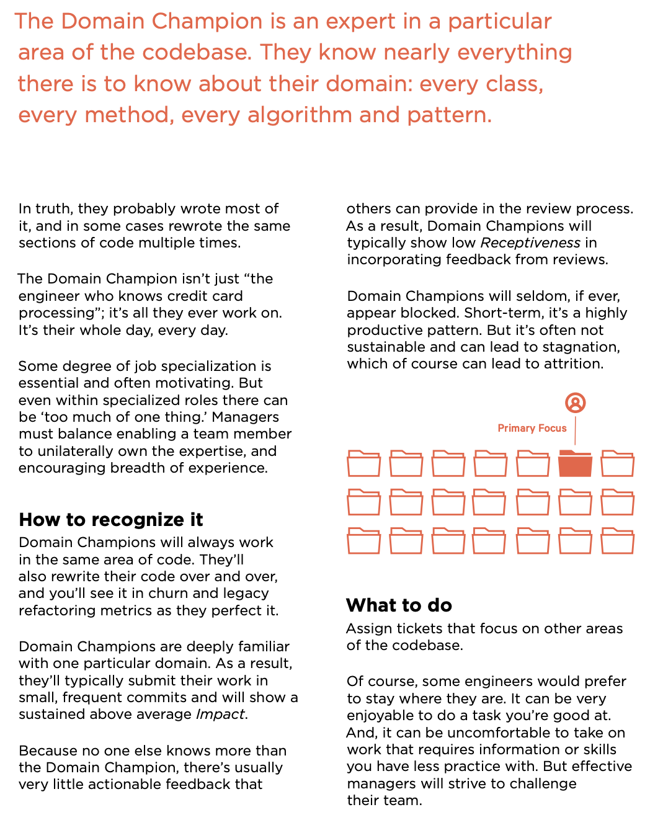
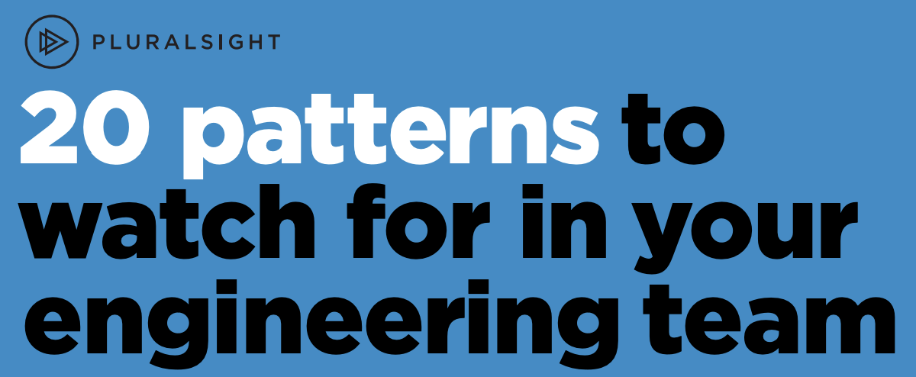
Example pattern: Domain champion
“The Domain Champion is an expert in a particular area of the codebase. They know nearly everything there is to know about their domain: every class, every method, every algorithm and pattern. ”
Why do we care?
Can lead to great productivity
Code quality implications
Turnover effects on code -- what happens to the domain when the domain champion leaves?
Notes:
Spack, February 2021

Slide 16
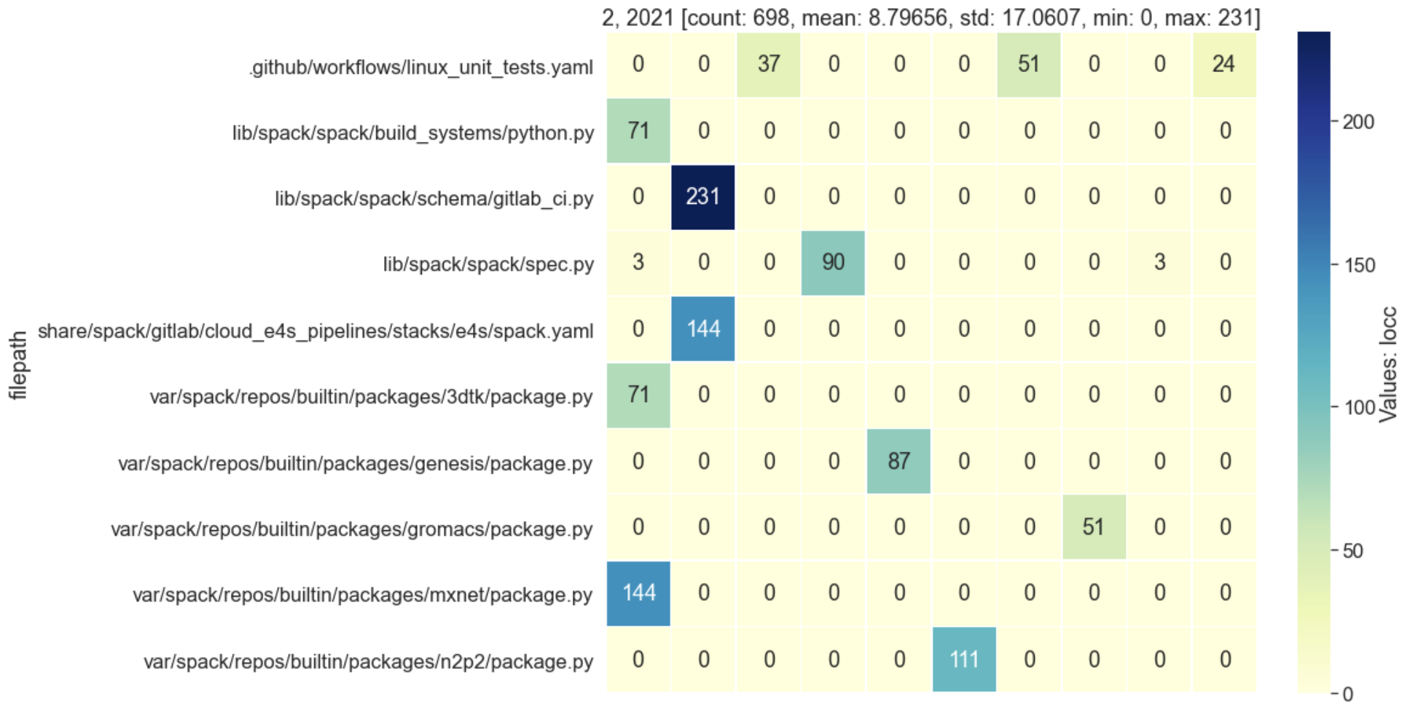
Domain champion pattern: How do we detect it?
“The Domain Champion is an expert in a particular area of the codebase.”
Can be computed over any specific period.
February, 2021
Can also consider other notions of “domain”, e.g., class, package, module, etc.
Can consider different “change” metrics, more on that later.
Lines of Code Changed (LOCC)
Files
Individual developers or subteams
Developers
Notes:
Spack, February 2021

Slide 17
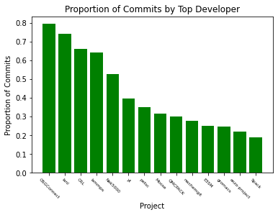
Domain Champion Pattern: What, if anything, should we do?
“The Domain Champion is an expert in a particular area of the codebase.”
Highly productive pattern in the short term.
There’s usually very little actionable feedback that others can provide in code reviews.
Potentially not sustainable → can lead to stagnation.
☺Possible actions:
Assign the DC tickets for other areas of the code.
Make an effort to involve others (e.g., new developers) in work in that domain.
One possible extension: Project Champion
Proportion of commits by the most active developer
Projects
Notes:
Spack, February 2021

Slide 18
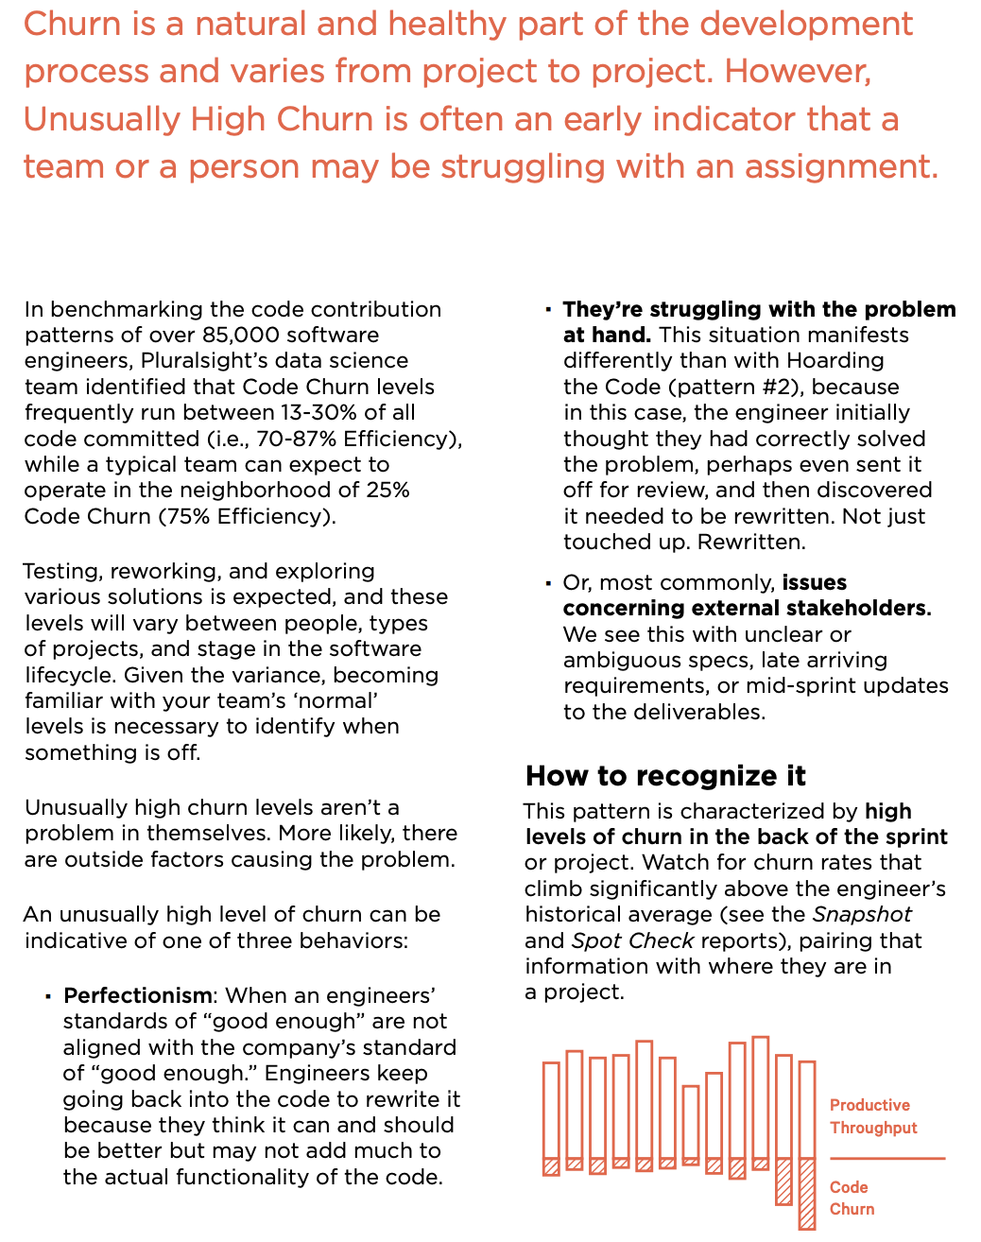
Another example pattern: Unusually high churn
(Code churn: code that is rewritten or deleted shortly after being written)
What files (components) have unusually large or frequent changes? How many developers are involved?
could be a sign of normal productive development
may indicate need for more developer resources
high conflict potential
Notes:
“Churn is a natural and healthy part of the development process and varies from project to project. However, Unusually High Churn is often an early indicator that a team or a person may be struggling with an assignment.”
Heatmap: Spack

Slide 19
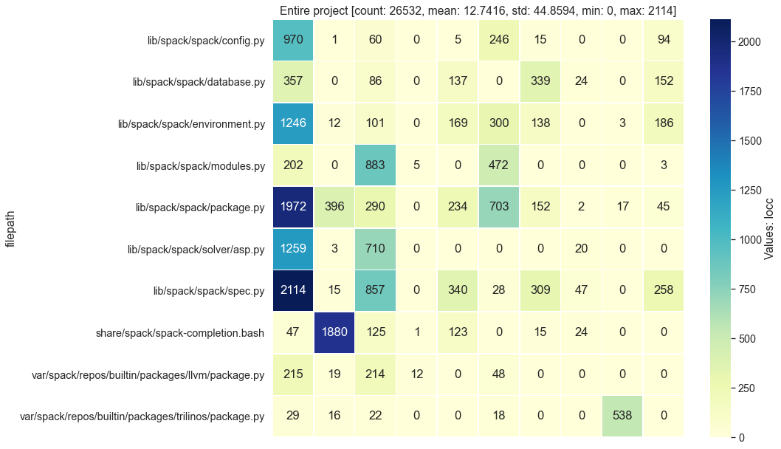
Unusually high churn pattern: How do we detect it?
Decide on the granularity. Some possibilities: modules, classes, files, functions.
Define the actors -- groups of people (e.g., sub-teams), individual developers; doesn’t have to be people, it can also be milestones or other project entities.
Choose the time period.
Choose the churn metric. Some examples: lines of code, cos (and other) difference between code versions, number of PRs, commits, number of files.
Total changes: Developers vs. files
(over the entire project history)
Developers
Notes:
“Churn is a natural and healthy part of the development process and varies from project to project. However, Unusually High Churn is often an early indicator that a team or a person may be struggling with an assignment.”
Heatmap: Spack

Slide 20
Unusually high churn pattern: What to do?
Unusually large amount of changes to single files or components may lead to development inefficiencies.
☺Possible actions:
Consider refactoring the high-churn project components
Consider involving more developers in high-churn areas that are dominated by a single person
Total changes: Developers vs. files
(over the entire project history)
Developers
Notes:
“Churn is a natural and healthy part of the development process and varies from project to project. However, Unusually High Churn is often an early indicator that a team or a person may be struggling with an assignment.”
Heatmap: Spack

Slide 21
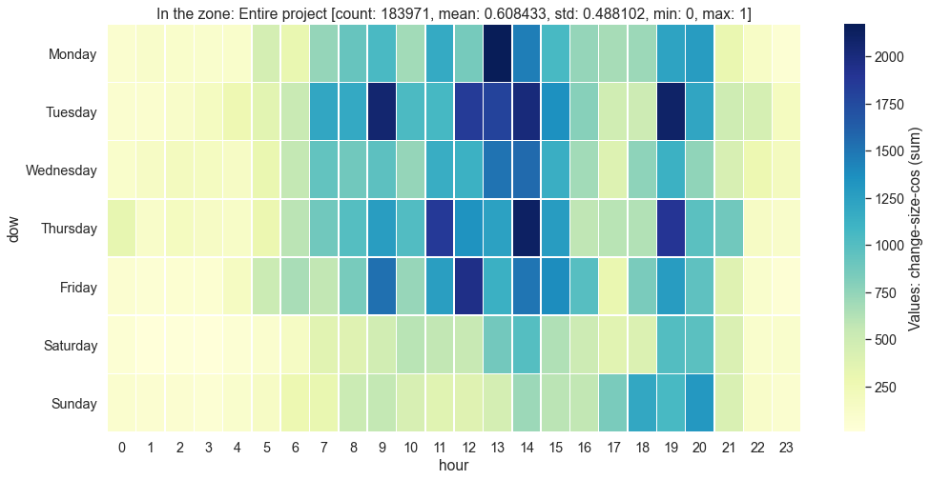
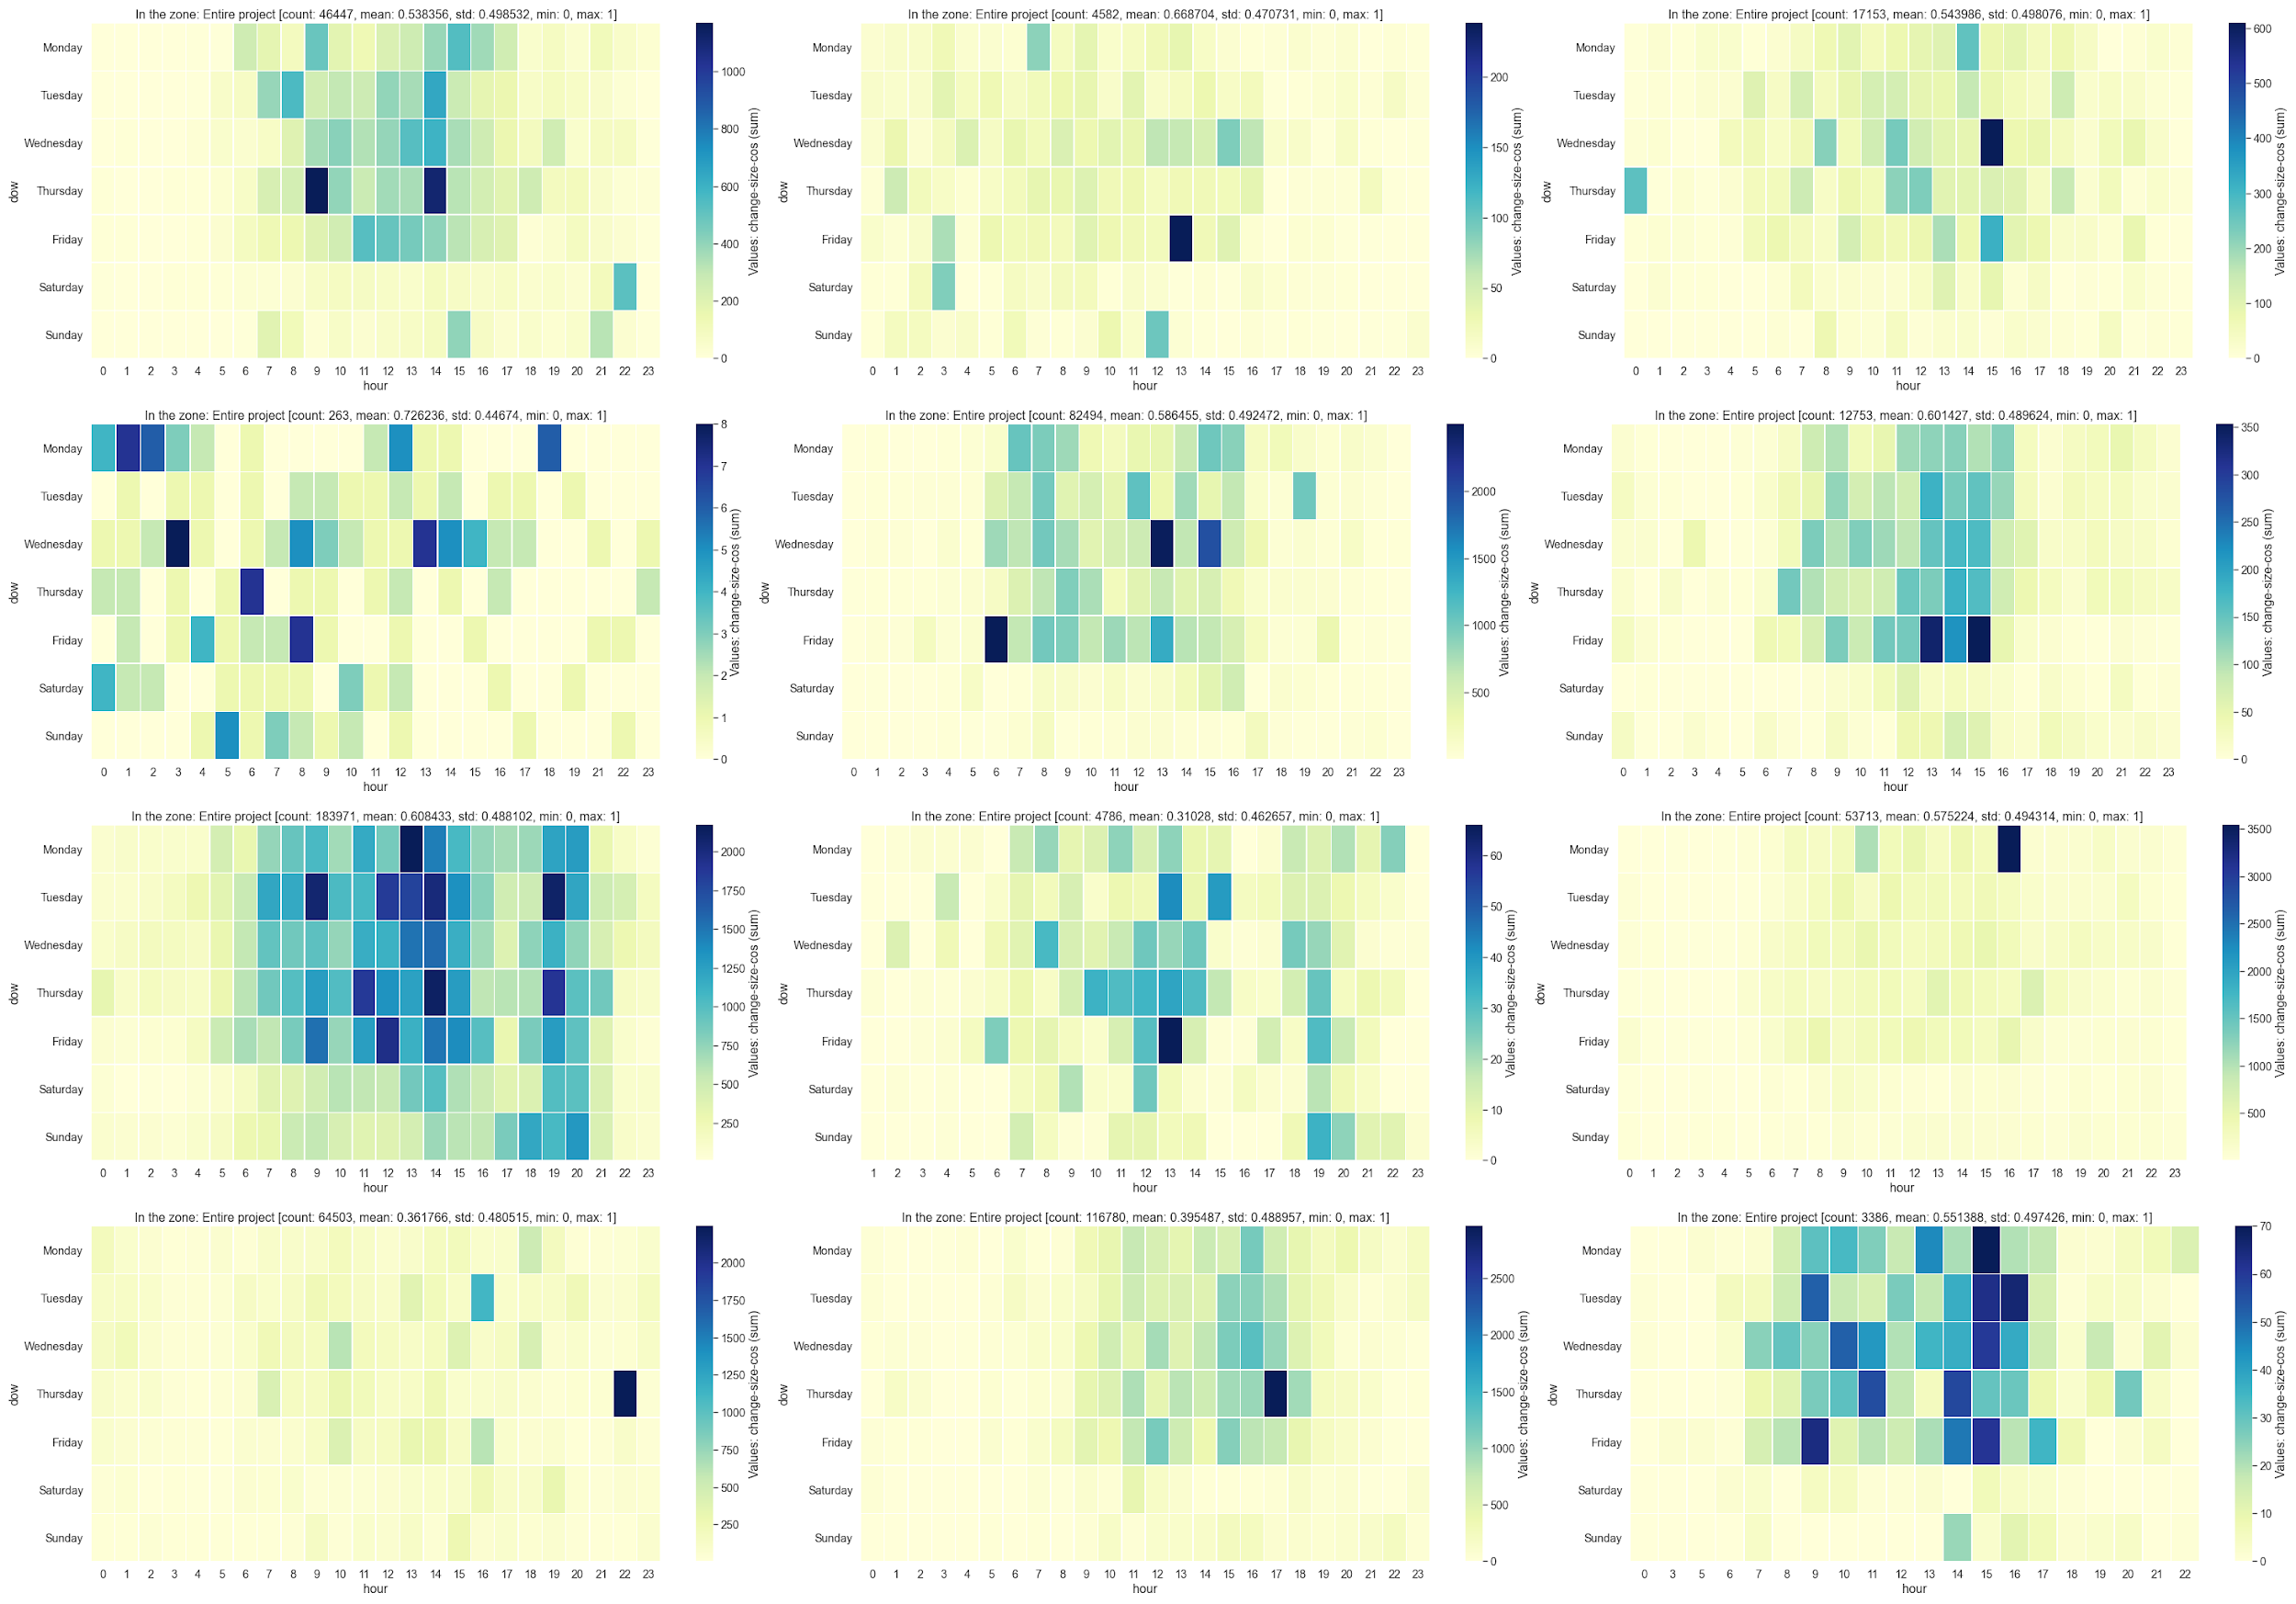
Pattern: In the zone
Weekday
When are top contributors most productive?
Consistent high productivity during certain times of day
Burnout, work-life balance
Peak times
Change: cosine difference
Hour
How to compute?
Choose productivity metric (LOCC, text difference, # commits, # PRs, etc.)
Choose time period
Choose visualization
Notes:
petsc

Slide 22
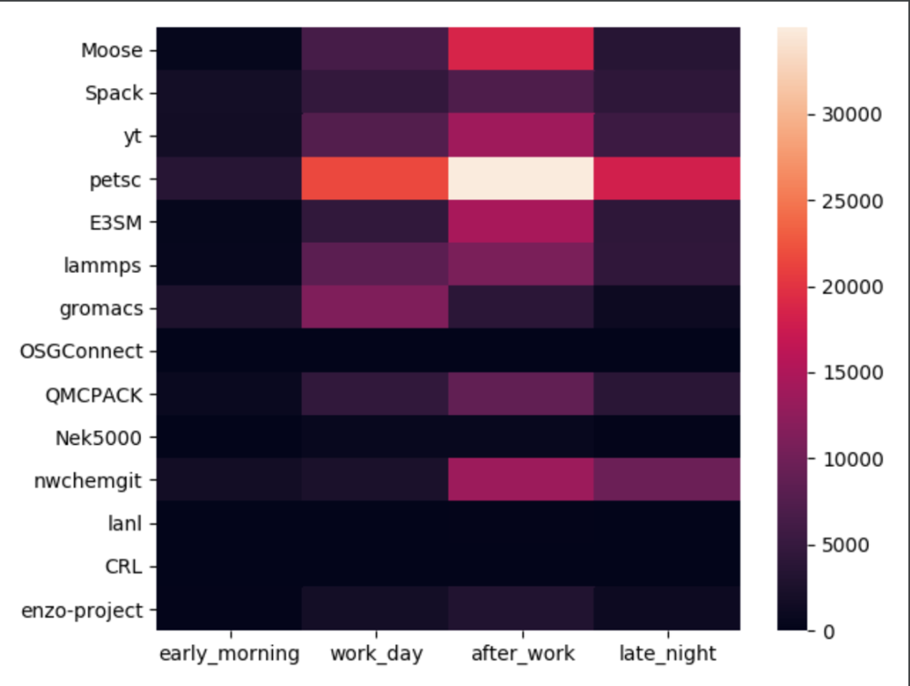
In the zone pattern: What to do?
When are top contributors most productive?
Consistent high productivity during certain times of day
Burnout, work-life balance
☺Possible actions:
Acknowledge the consistently high-performing developers.
Recognize and acknowledge positive change in non-top developers (e.g., junior or new contributors).
Consider the timing of and number of meetings during developers’ most productive times.
Bonus: Ability to quickly “see” what people are doing on average. Below: The average of over a dozen ECP projects’ most active time periods.
After work!
Projects
Notes:
petsc

Slide 23
Technical Details and Examples
https://bit.ly/DevPatterns

Slide 24
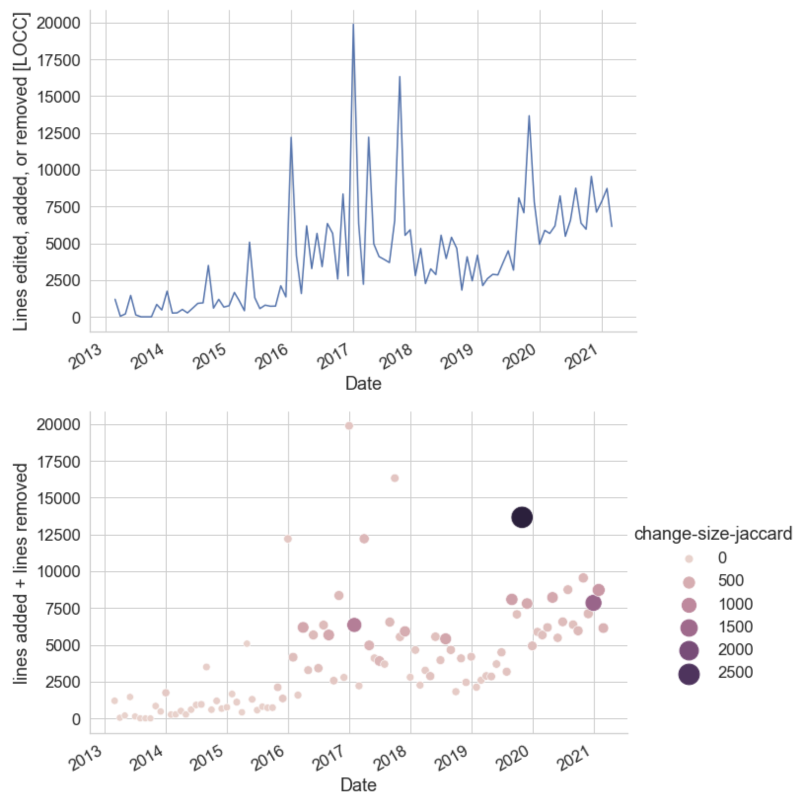
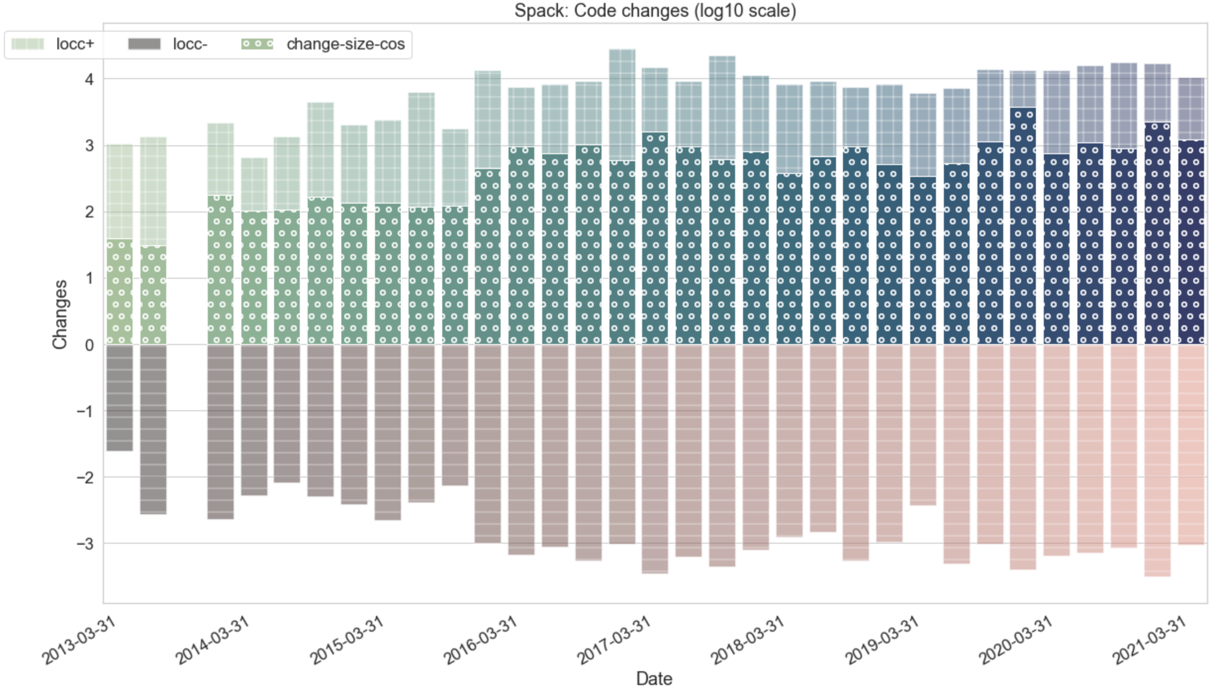
Implementation
https://bit.ly/DevPatterns
Example analysis workflow
from patterns.visualizer import Visualizer
vis = Visualizer(project_name='spack')
vis.get_data()
INFO: Loaded local cached copy of spack data.
INFO: Done computing averages. 64909 commits (code only)
df = vis.plot_overall_project_locc(time_range=None, log=True)
Python packages
Jupyter notebooks
database
patterns
visualizer
Local project cache
Git commits. Issues, emails
https://github.com/HPCL/ideas-uo/
MySQL Database
Some currently available projects (more are being added constantly): LAMMPS, Spack, PETSc, Nek5000, NWChem, E3SM, QPMCPACK, qdpxx, NWChem, TAU,... Initial import can take up to 36 hours for some larger projects, but subsequent updates are fast and automated.

Slide 25
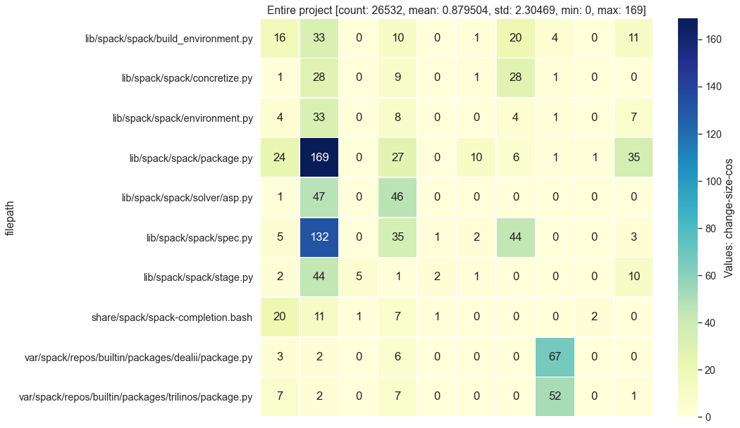
Impact of different “change” estimates
Simple line counts in git commit diffs:
Patterns such as ‘---+++’ are counted as edited lines, e.g., 3 in this example
Unmatched ‘-’ and ‘+’ lines counted as lines deleted and added, respectively
LOCC = edited + deleted + added
Files
Developers
More “intelligent” estimate of the magnitude of changes:
Collect the old and new strings corresponding to each commit’s diffs
Apply text distance metrics (based on the textdistance Python package; ~30 methods)
E.g., change-size-cos is the cos distance between the vector embeddings of old and new
Files
Developers

Slide 26
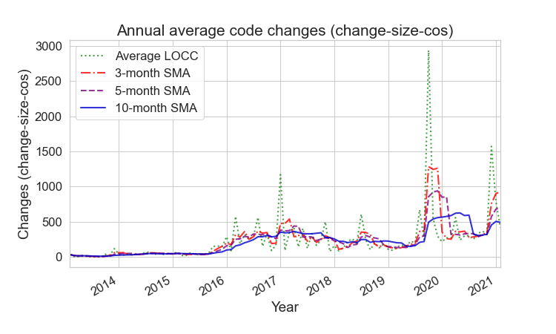
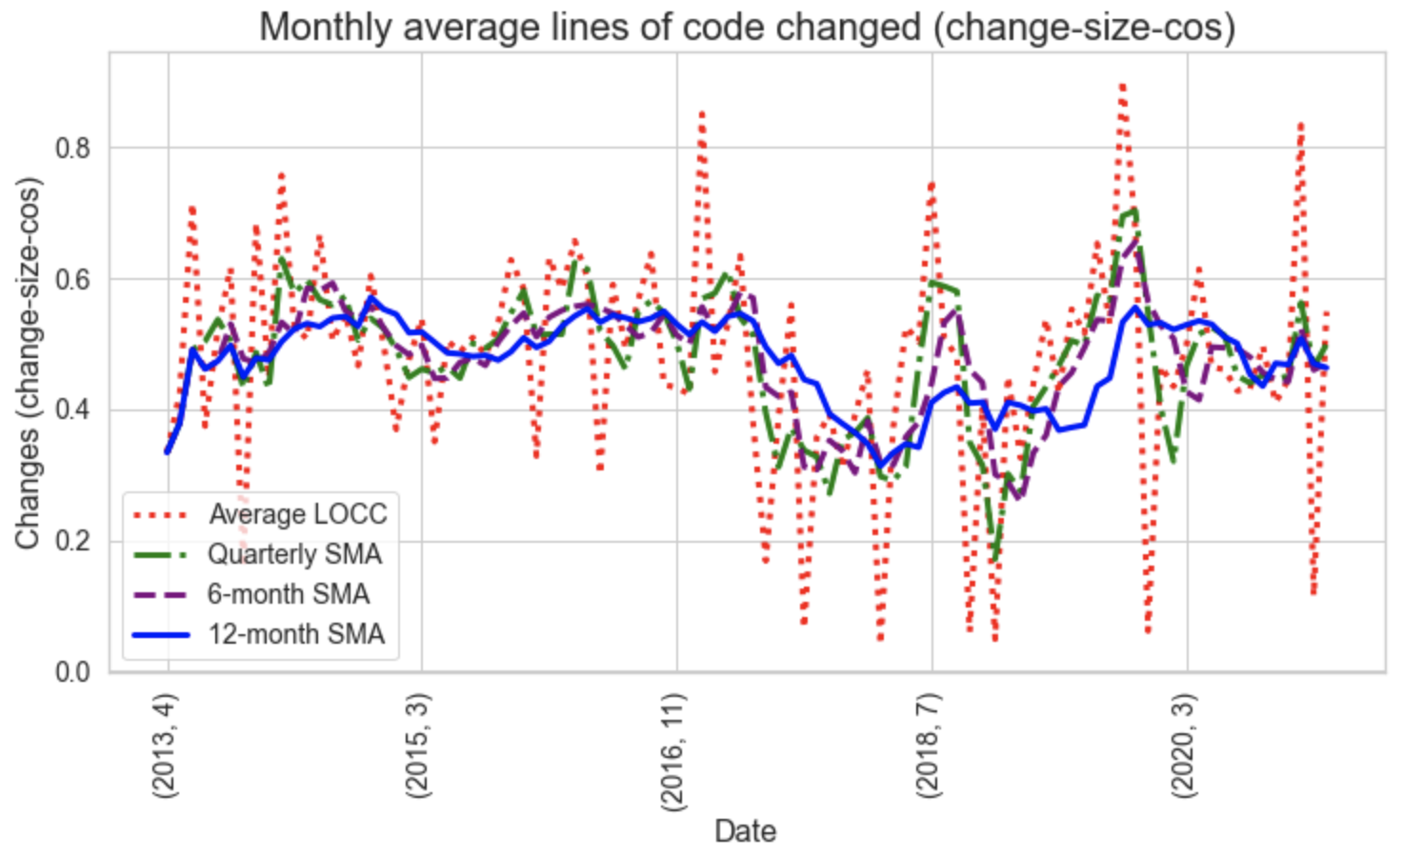
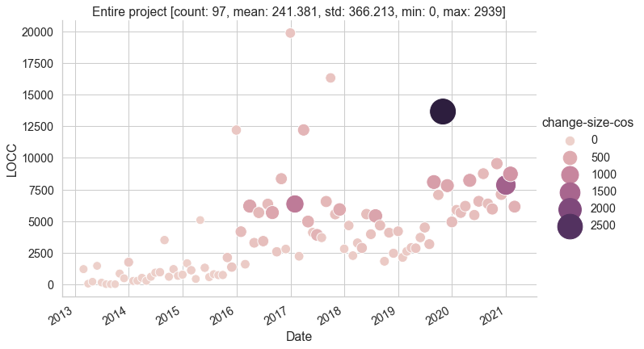
Impact of different “change” estimates (cont.)
Time-series git data is messy
Moving averages help see trends for any time period
nd cosine distance
Combining different “change size” metrics
Example on right: simple LOCC totals and cos distance
Notes:
Spack

Slide 27
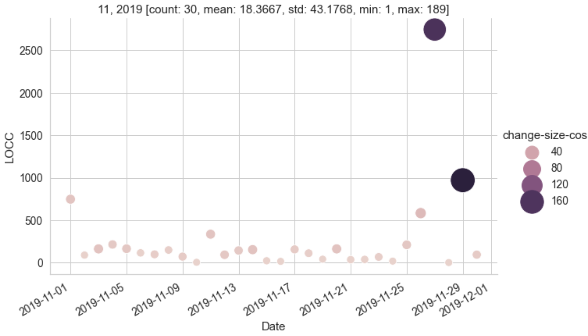
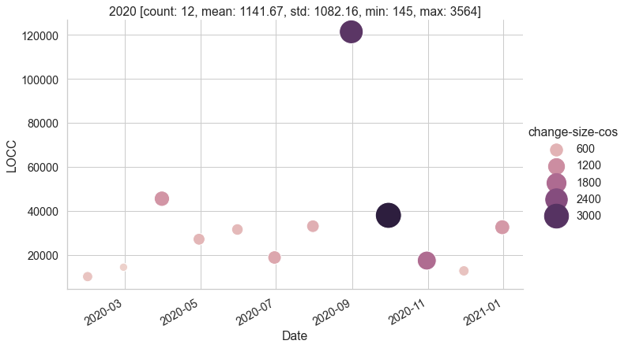
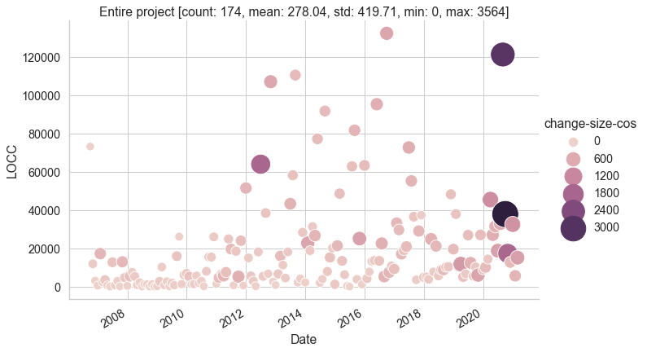
Significant events
Project 1
Project 2
Notes:
Spack, LAMMPS

Slide 28
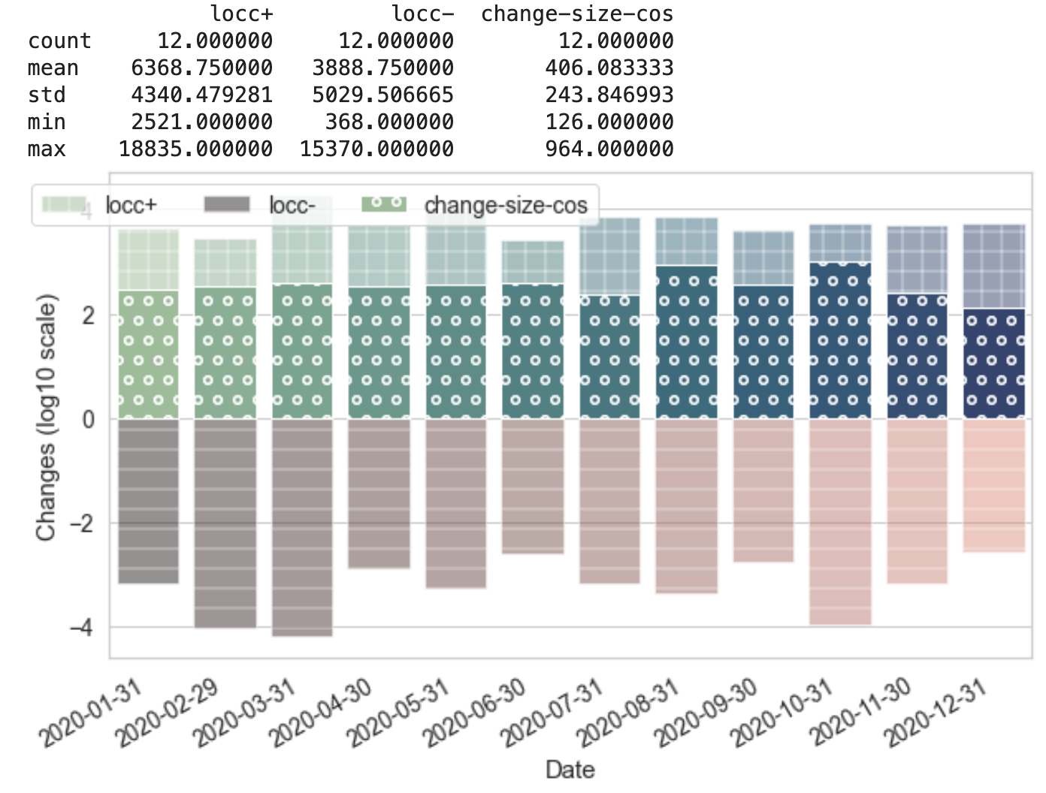
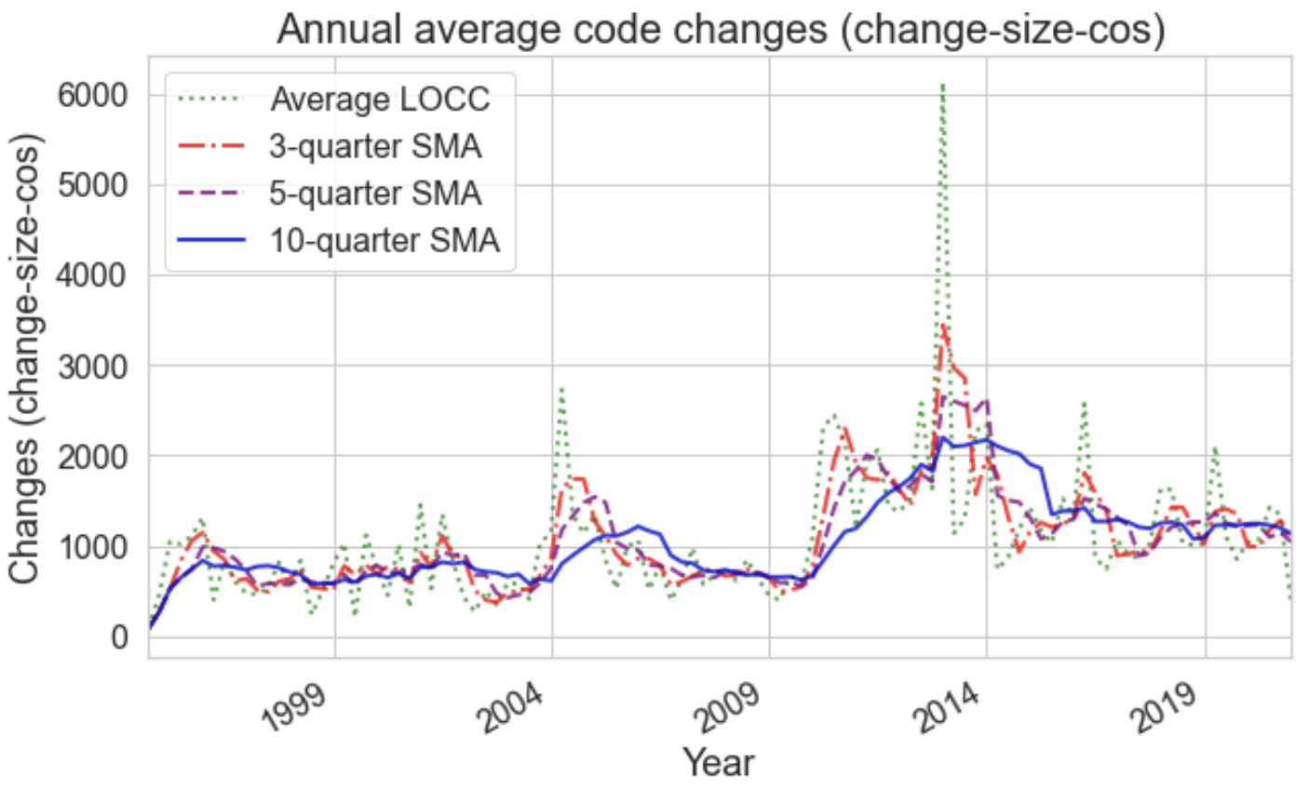
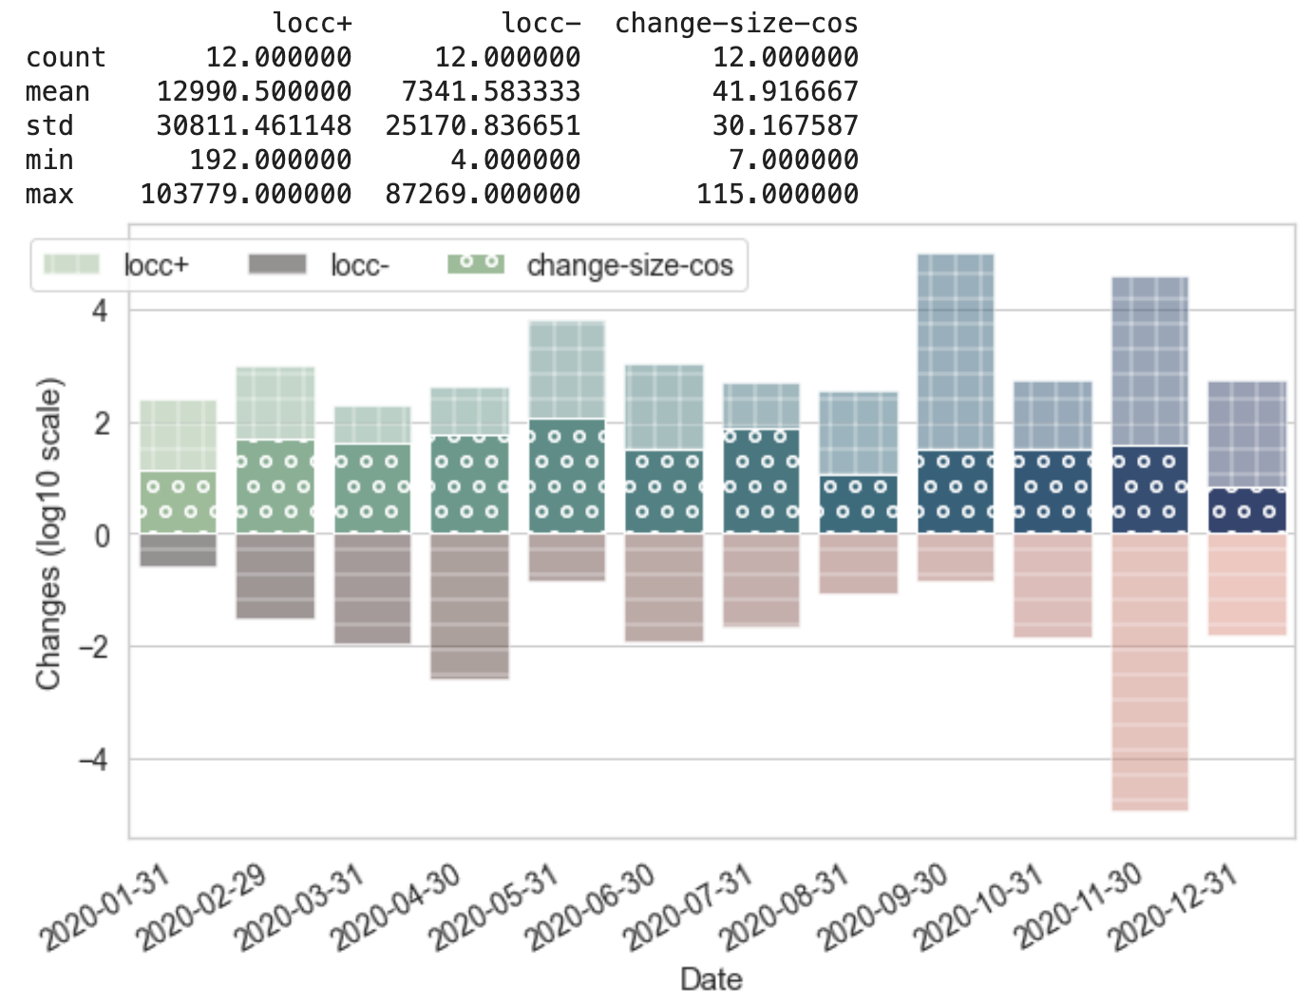
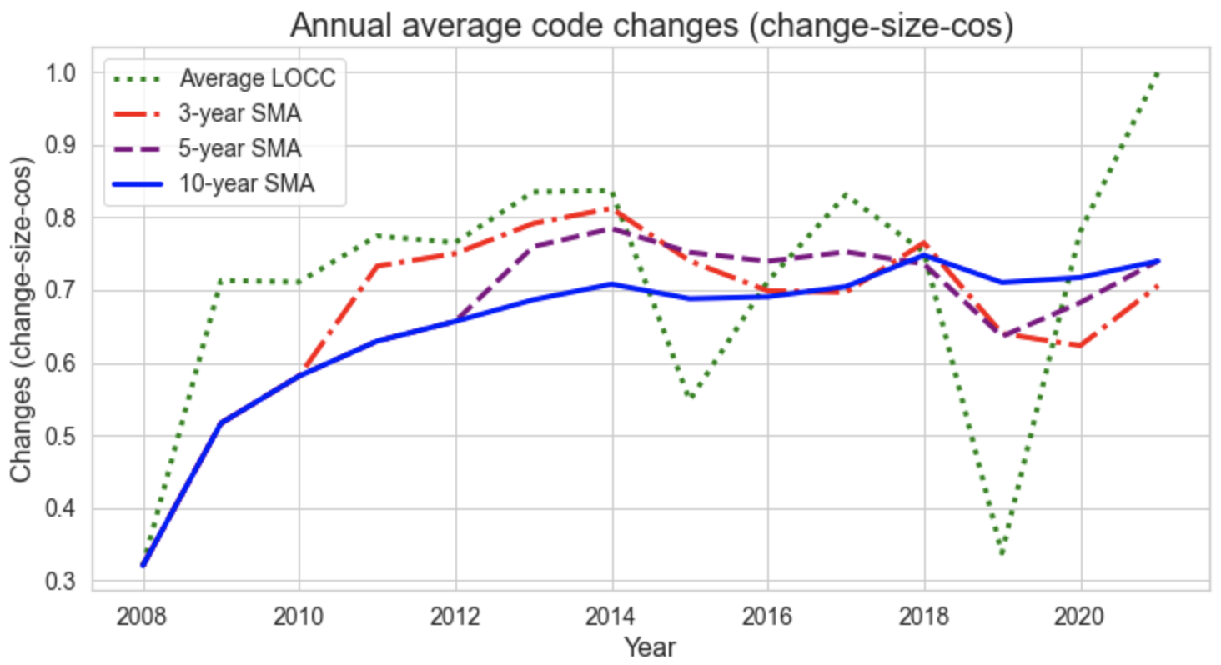
No single view tells the whole story
(project names omitted deliberately)
2020
Project 1
Project 2
Notes:
PETSc, TAU

Slide 29
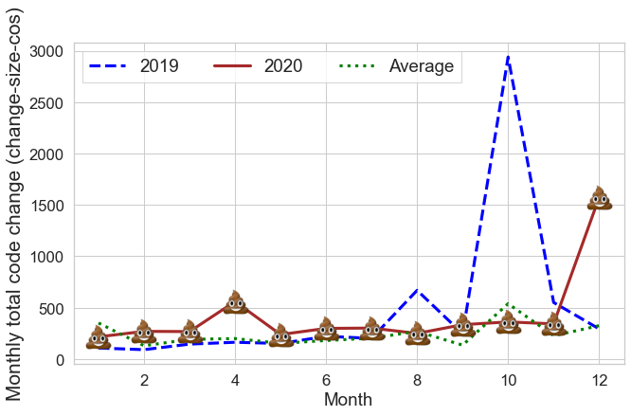
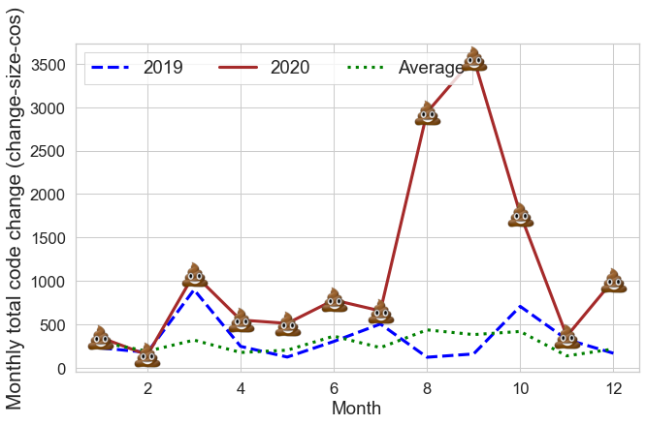
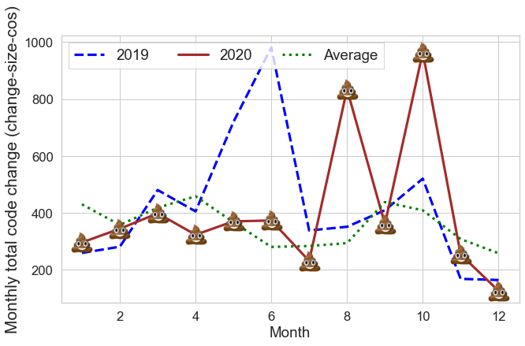
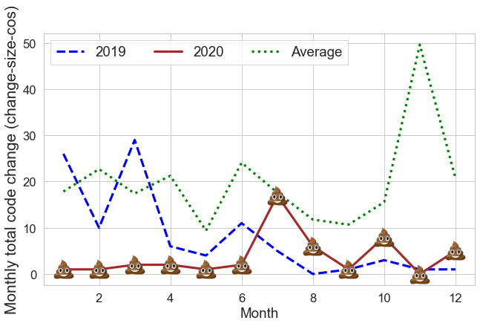
How do projects weather interesting times?
Project 1
Project 2
Project 3
Project 4
Notes:
Spack, Lammps, PETSc, NEK5000

Slide 30
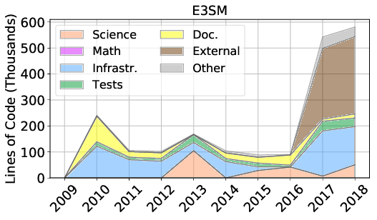
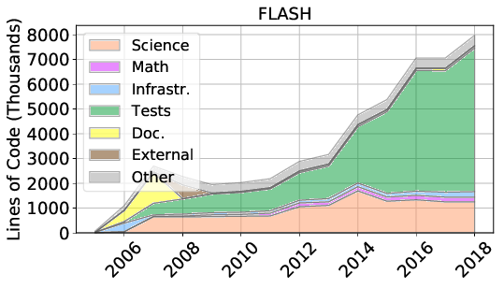
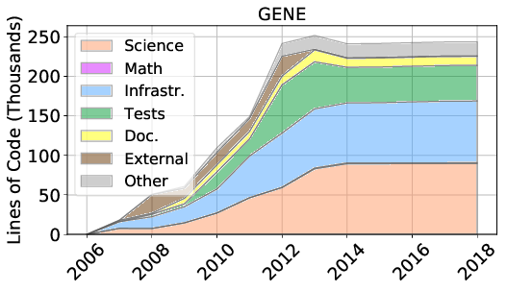
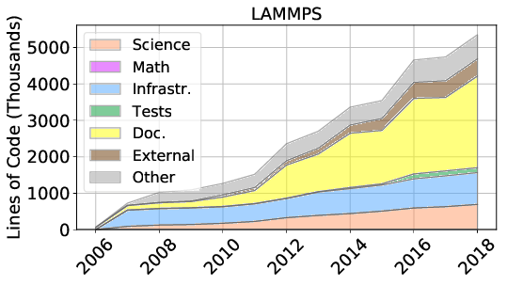
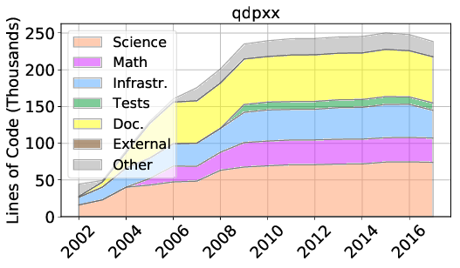
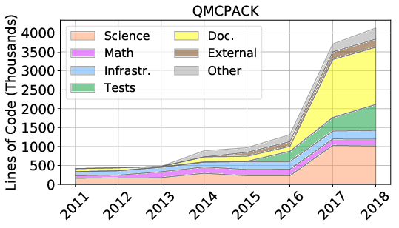
Where is development effort going?
Grannan, A., Sood, K., Norris, B., & Dubey, A. (2020). Understanding the landscape of scientific software used on high-performance computing platforms. The International Journal of High Performance Computing Applications. https://doi.org/10.1177/1094342019899451

Slide 31
Example Tool: MeerCAT Using git data to improve developer processes and efficiency

Slide 32
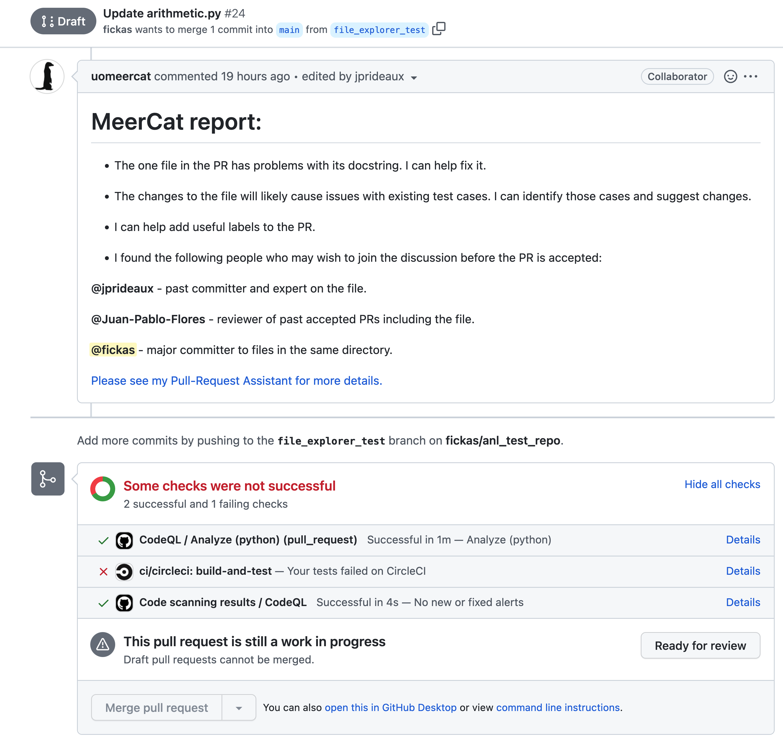
A Draft PR is created to merge feature branch into main branch.
The MeerCat PRA triggers and analyzes file changes and reports back.
More traditional Code Quality and testing tools trigger and report results.

Slide 33
The MeerCat PRA provides the following analysis:
Are required docstrings in place and actually match the code?
If changes to files will cause existing test cases to become misaligned.
Potentially useful labels to add to the PR for other tools to use.
Suggests other people to add to the discussion given their prior roles related to files in this PR.
The link will take the user to the MeerCat PRA site for further refinement of the PR (see next slide).

Slide 34
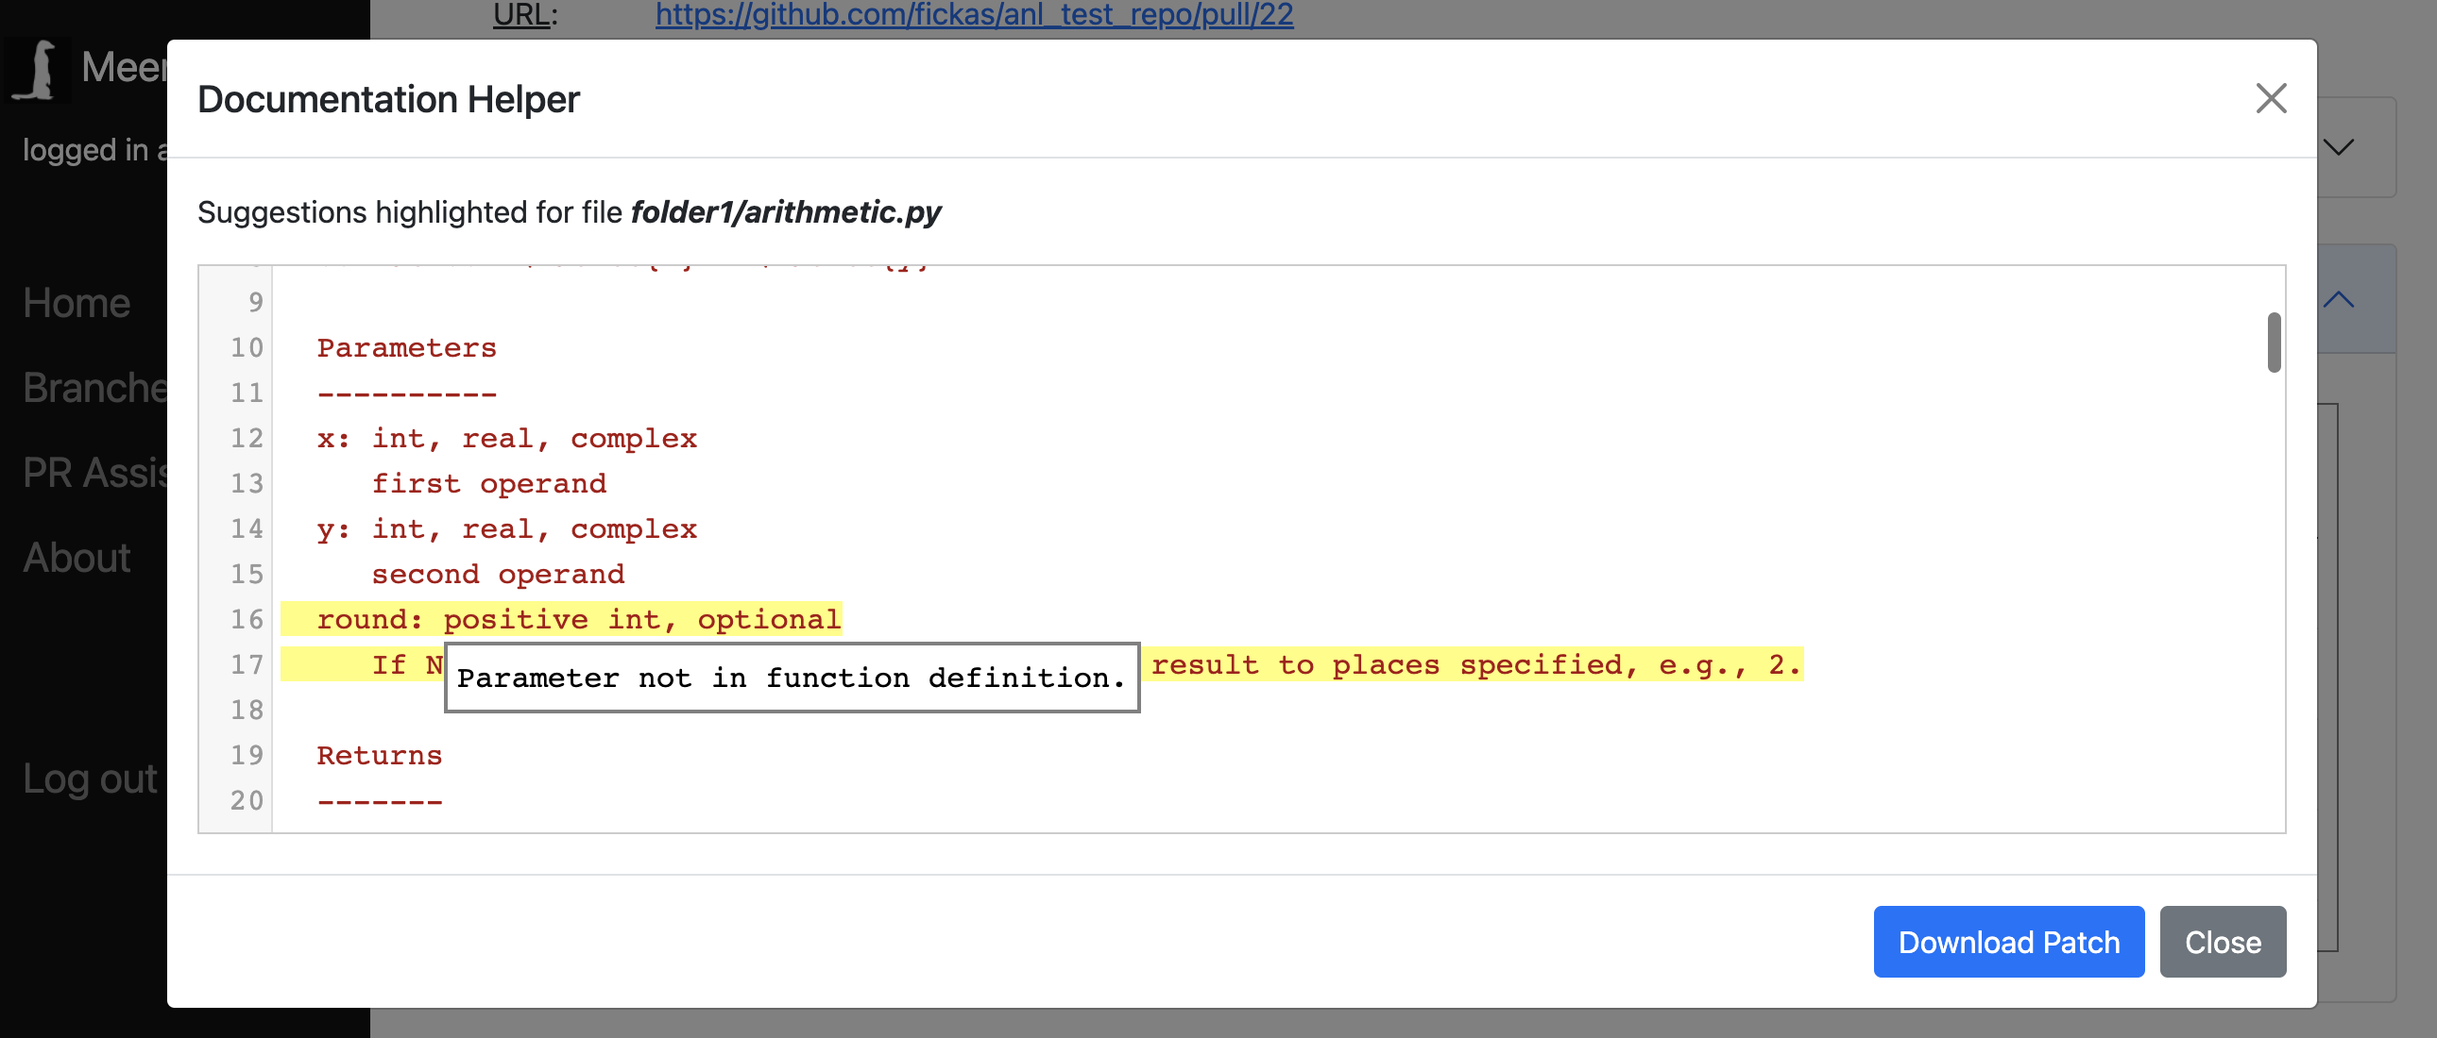
Once the user is at the PRA site, several aids are available.
After analysis, the PRA finds that one commit has removed a parameter from a function sub, but there is been no change to the documentation, i.e., code and documentation are misaligned.
Here the PRA editor is highlighting the Numpy docstring code that needs to be changed and why.
The user can download changes made to a Git Patch file and then easily merge in with existing PR.

Slide 35
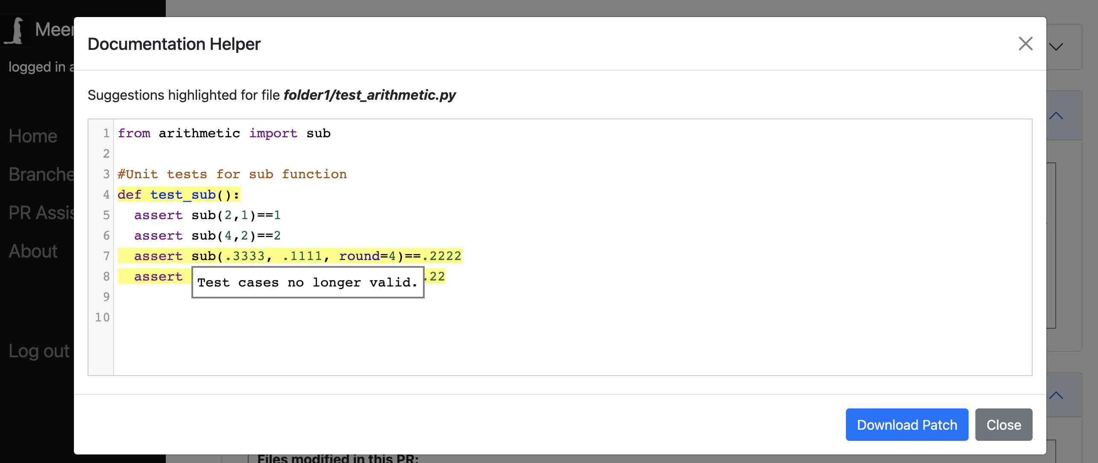
The PRA can also search the repo for test files that reference the now changed sub function.
It discovers one such file (now misaligned) and suggests changes in the editor. Once the user removes the now invalid cases, the PRA will add the test file (and commits) to the existing Pull Request through the Patch mechanism.
The user can download changes made to a Git Patch file and then easily merge in with existing PR.

Slide 36
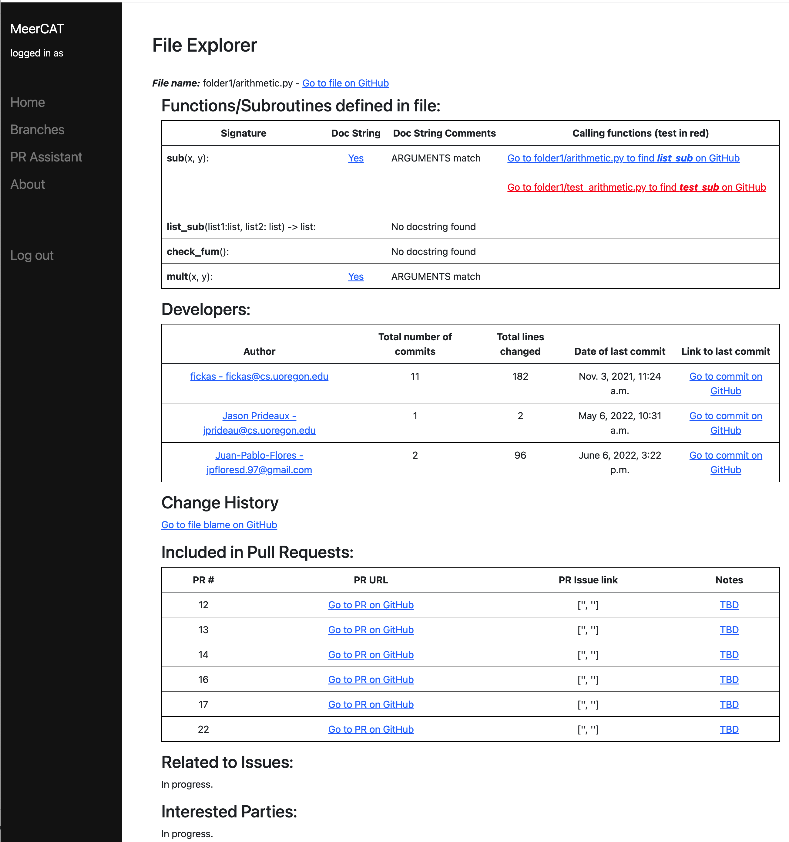
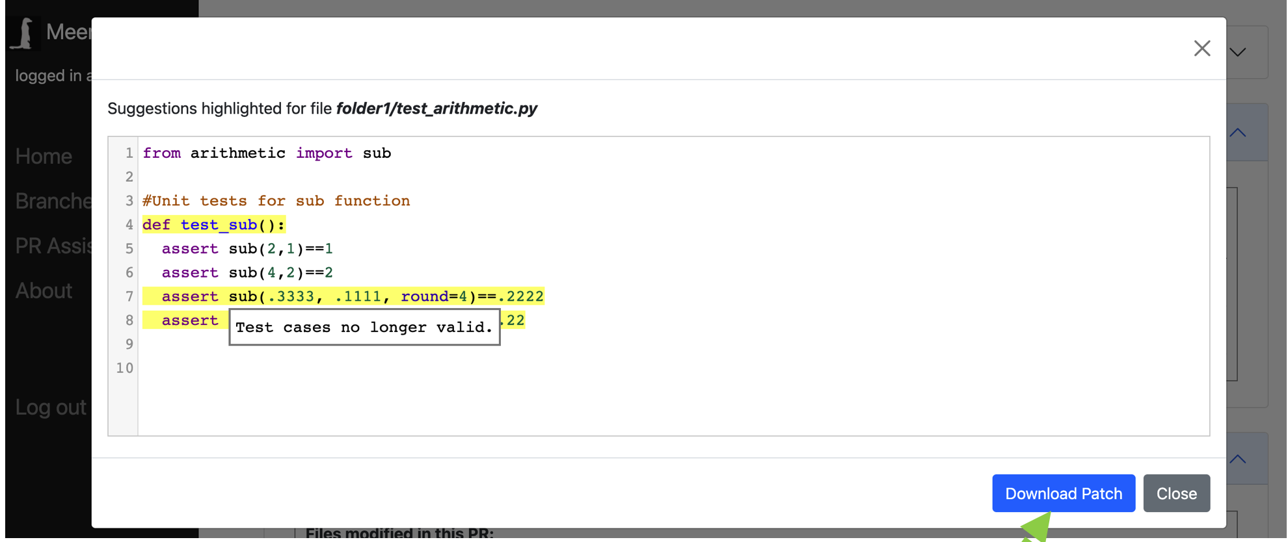
MeerCAT: File Explorer
MeerCat does analysis and leaves comment in GitHub PR
If user clicks link, she is taken to the PRA tool (previous slides).
From the PRA, click on a specific file to get to the file explorer.
Benefits:
+ Problems detected early, don’t have to wait for CI failure
+ Better overall documentation, testing

Slide 37
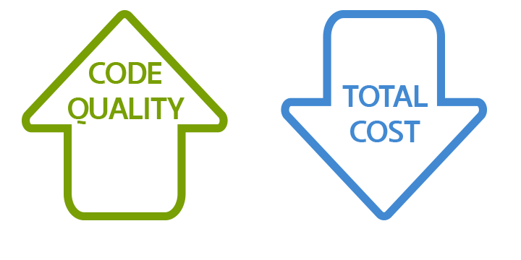
Part II: Analyzing Code

Slide 38
Defects that code analyses can catch
Security: Buffer overruns, improperly validated input.
Memory safety: Null dereference, uninitialized data.
Resource leaks: Memory, OS resources.
API Protocols: improper use of APIs, incomplete/incorrect implementations
Exceptions: Arithmetic/library/user-defined
Encapsulation: Accessing internal data, calling private functions.
Data races: Two threads access the same data without synchronization
Key idea: check compliance with (mostly) simple, mechanical design rules.
Standard: ISO/IEC 5055:2021(E): Information technology — Software measurement — Software quality measurement — Automated source code quality measures

Slide 39
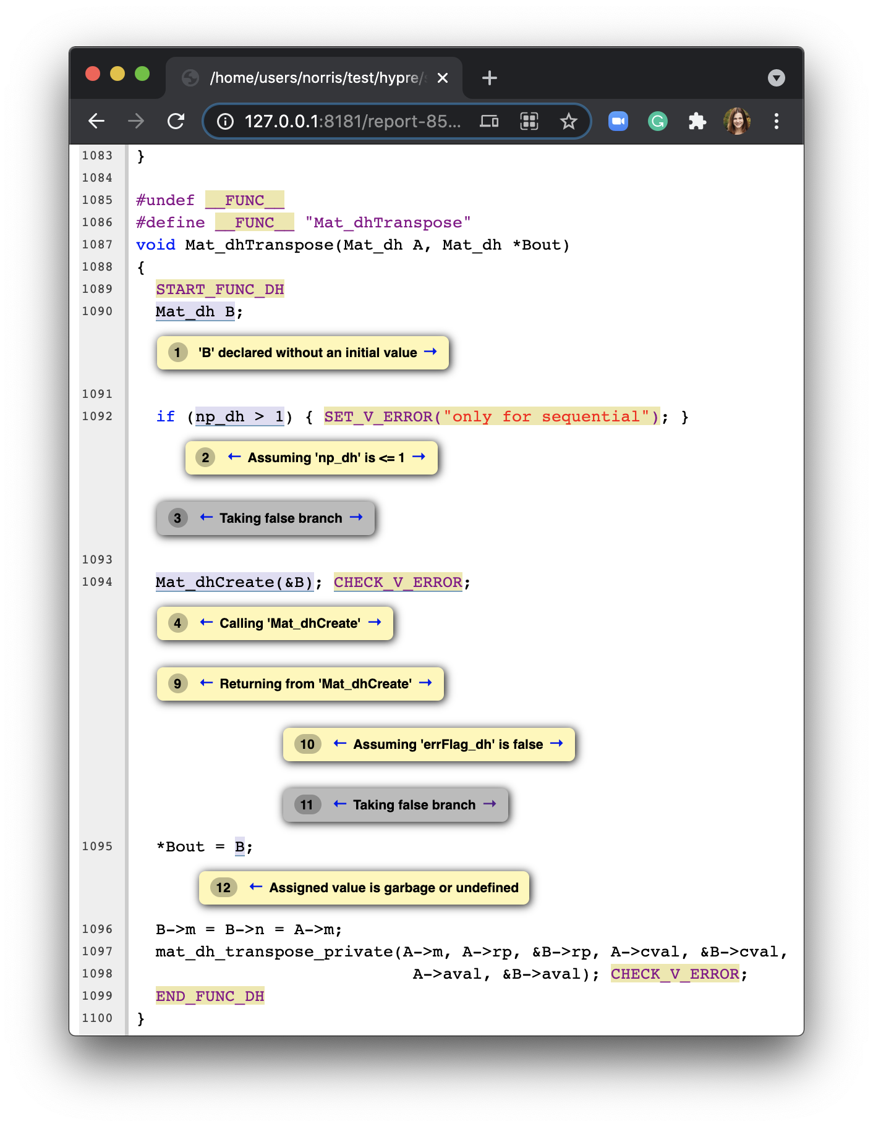
General-purpose tools for code checking (bugs, style)
C/C++
Run a bunch of general analyses with scan-check (wrapper around clang --analyze, which is uses the static analyzer below)
Minimally invasive, not very customizable
Works great with CMake and Autoconf builds
Clang static analyzer component: extensible analysis framework for bug finding
Can do more complex analyses (path-sensitive, inter-procedural analysis based on a symbolic execution technique)
Requires more compiler knowledge to extend
Clang-tidy: extensible (libTooling-based) framework for diagnosing typical programming errors or style issues
Checking and enforcing of simple coding conventions
Modular, provides API for implementing new checks
Relatively easy to integrate into Cmake
Fortran
Flang (compiler front-end to LLVM)
Fortran-linter (limited)
Notes:
https://patchwork.kernel.org/project/linux-kbuild/patch/20200708181905.257691-1-nhuck@google.com/#23477427
On Wed, Jul 8, 2020 at 11:21 AM 'Nathan Huckleberry' via Clang Built
Linux <clang-built-linux@googlegroups.com> wrote:
>
> This patch adds clang-tidy and the clang static-analyzer as make
> targets. The goal of this patch is to make static analysis tools
> usable and extendable by any developer or researcher who is familiar
> with basic c++.
>
> The current static analysis tools require intimate knowledge of the internal
> workings of the static analysis. Clang-tidy and the clang static analyzers
> expose an easy to use api and allow users unfamiliar with clang to
> write new checks with relative ease.
>
> ===Clang-tidy===
>
> Clang-tidy is an easily extendable 'linter' that runs on the AST.
> Clang-tidy checks are easy to write and understand. A check consists of
> two parts, a matcher and a checker. The matcher is created using a
> domain specific language that acts on the AST
> (https://clang.llvm.org/docs/LibASTMatchersReference.html). When AST
> nodes are found by the matcher a callback is made to the checker. The
> checker can then execute additional checks and issue warnings.
>
> Here is an example clang-tidy check to report functions that have calls
> to local_irq_disable without calls to local_irq_enable and vice-versa.
> Functions flagged with __attribute((annotation("ignore_irq_balancing")))
> are ignored for analysis. (https://reviews.llvm.org/D65828)
>
> ===Clang static analyzer===
>
> The clang static analyzer is a more powerful static analysis tool that
> uses symbolic execution to find bugs. Currently there is a check that
> looks for potential security bugs from invalid uses of kmalloc and
> kfree. There are several more general purpose checks that are useful for
> the kernel.
>
> The clang static analyzer is well documented and designed to be
> extensible.
> (https://clang-analyzer.llvm.org/checker_dev_manual.html)
> (https://github.com/haoNoQ/clang-analyzer-guide/releases/download/v0.1/clang-analyzer-guide-v0.1.pdf)
>
> The main draw of the clang tools is how accessible they are. The clang
> documentation is very nice and these tools are built specifically to be
> easily extendable by any developer. They provide an accessible method of
> bug-finding and research to people who are not overly familiar with the
> kernel codebase.
>
> Signed-off-by: Nathan Huckleberry <nhuck@google.com>
> ---
> Changes V1 -> V2:
> * Remove dependencies on GNU Parallel
> * * Clang-tidy/analyzer now invoked directly from python
> Link: https://lkml.org/lkml/2019/8/6/941
>
> Makefile | 3 +
> scripts/clang-tools/Makefile.clang-tools | 23 ++++++
> .../{ => clang-tools}/gen_compile_commands.py | 0

Slide 40
Example development workflow that considers code quality
Example “make commit” workflow (easy in C/C++, and hopefully possible soon for Fortran):
clang-format passes and reformats the code
clang-tidy passes and enforces coding conventions
clang static analyzer compiles debug and production builds (check errors)
Project-specific analysis for debug and production build (check errors)
debug/production builds get compiled and unit tests launched (check errors)
production build + unit tests run under valgrind (check errors)
production build gets compiled and unit test launched (check errors)
production build with --coverage gets compiled and unit test launched against llvm-cov (write unit-test coverage stats)

Slide 41
Our goals and approach
Make it easy(-ish) to define and apply static and dynamic program analysis techniques to identify quality-related problems in HPC codes.
How? Two parts:
By integrating general static and dynamic program analyses into the HPC software development process: mainly through documentation and examples.
By creating easy interfaces to custom analyses, with examples.
Why?
Abstraction
Elide details of a specific implementation.
Capture semantically relevant details; ignore the rest.
Programs as data
Programs are just trees/graphs!
…and we have lots of ways to analyze trees/graphs

Slide 42
Static program analysis is...
Ensure everything is checked the same way.
Examples:
clang-tidy
Clang static analyzer
Systematic examination of an abstraction of program state space.
Only track “important” things...
Applies to all possible executions.

Slide 43
Dynamic program analysis is...
Examples:
Valgrind
Clang/LLVM sanitizers (better!)
Instrumented code only.
Partial examination of an abstraction of a single execution path at runtime.
Applies to specific executions; can miss errors.
Can capture information not available statically.
Notes:
Examples: valgrind and clang’s own sanitizers, which instrument the code at run-time to detect actual errors (e.g., reading uninitialized memory) that happen while the code is running.
Clang sanitizers are runtime checkers used to identify suspicious and undefined behavior. The checking occurs at runtime with actual runtime parameters so false positives are kept to a minimum.

Slide 44
Implementation approach
Guiding principle: Whenever possible, leverage existing compiler infrastructure
C/C++:
Static: Clang Static Analyzer (Clang CFG-based) and clang-tidy interfaces (Matcher-based)
Integrate existing checks into library and application builds
Implement custom checkers based on coding policies (when available)
Produce even higher-level APIs to enable developers to extend checks
Check run during package builds
Questions/challenges:
How to deal with non-CMake builds? Spack support?
Output formats? (readable, understandable, actionable)
Minimize false positives
Dynamic: Python interfaces to the Clang sanitizer API
Used in our current implementation of PETSc development rule checking
Requires integration with build system and can be used during testing
Questions/challenges:
How to minimize runtime overheads?
Output formats for results? (readable, understandable, actionable)

Slide 45
Implementation approach (continued)
Guiding principle: Whenever possible, leverage existing compiler infrastructure:
Fortran:
Static: https://pypi.org/project/fortran-linter/ (extrermely limited)
Flang-based tools evolving (https://github.com/llvm/llvm-project/tree/main/flang)
Dynamic: ?
Yikes?

Slide 46
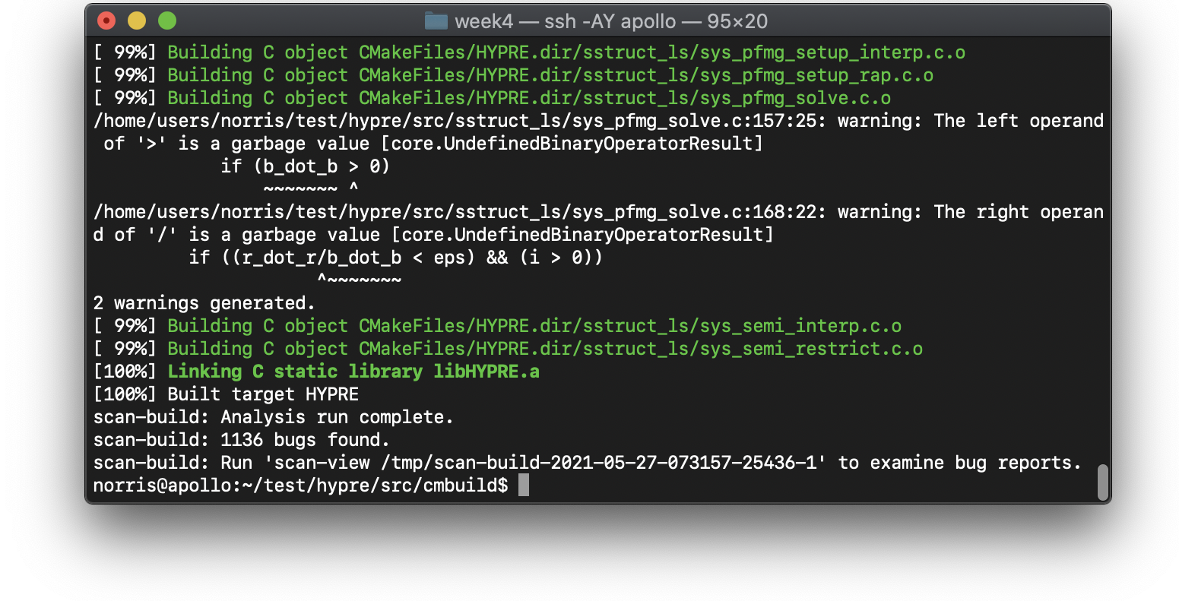
Example: Using scan-build with HYPRE¹
hypre/src/cmbuild$ scan-build cmake ..
hypre/src/cmbuild$ scan-build make
¹HYPRE: Scalable Linear Solvers and Multigrid Methods. https://github.com/hypre-space/hypre

Slide 47
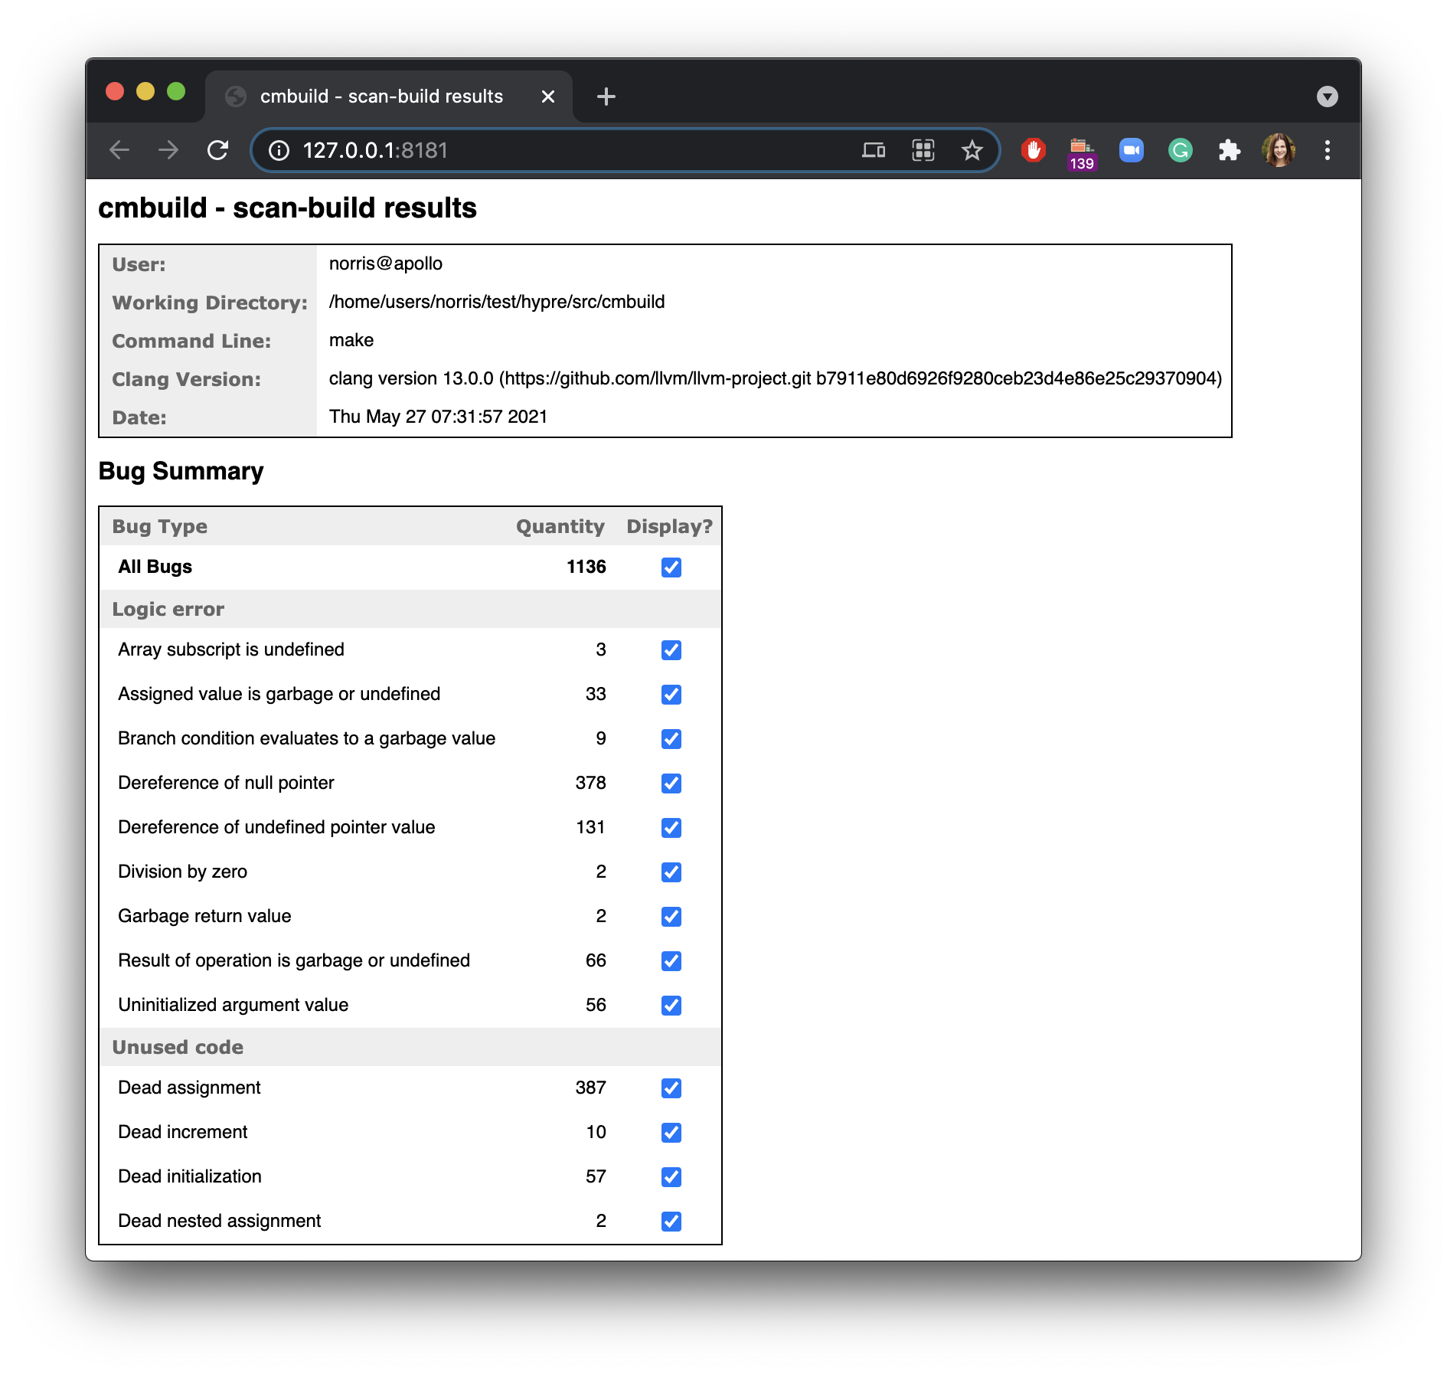
Example: hypre (cont.)
hypre/src/cmbuild$ scan-view /tmp/scan-build-2021-05-27-073157-25436-1
details
Eek! Too much information, can synthesize a more actionable report.
Notes:
scan-view /tmp/scan-build-2021-05-27-073157-25436-1

Slide 48
What about project-specific requirements?
Do you need to be a compiler expert to implement new program checks?
Thankfully -- no!

Slide 49
Implementation approach: Part B
Develop custom static and dynamic checking based on project-specific requirements.
C/C++
Static: use and extend existing APIs (Clang static analyzer, clang-tidy); implement custom AST traversals and matchers (more details next)
Dynamic: use Clang sanitizer APIs; python for simplicity and easy of extensions by HPC software developers
Fortran
Static: need to write new Flang-based checkers only for things that Fortran developers actually care about
Dynamic: do we need anything?

Slide 50
Example: Checking for violations of PETSc developer rules
From PETSc Style and Usage Guide: https://petsc.org/release/developers/style/

Slide 51
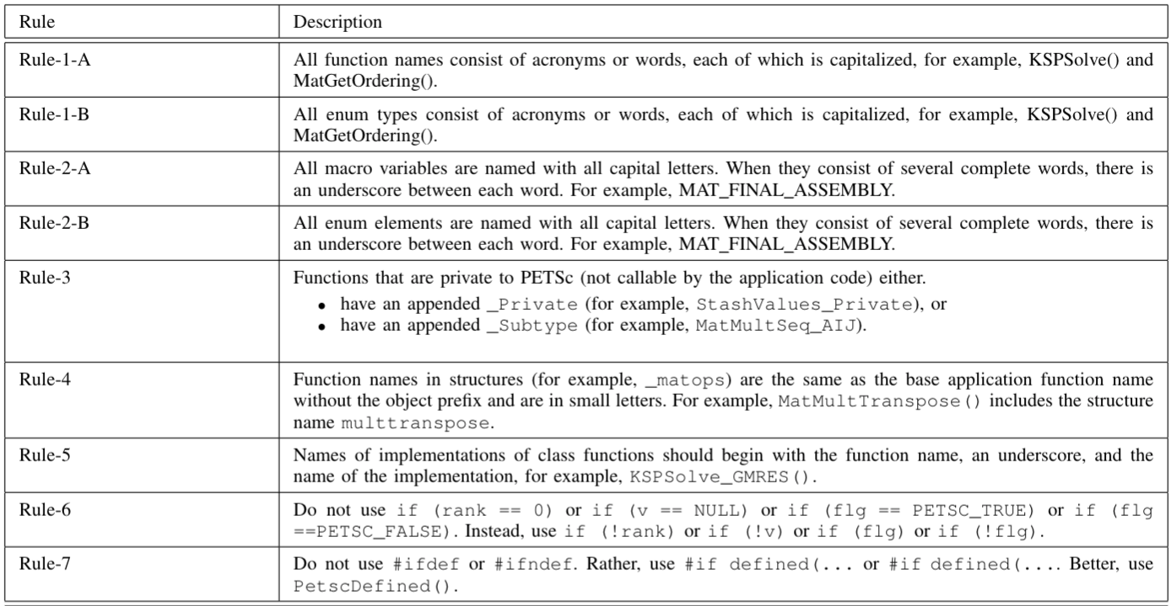
PETSc developer rules: https://petsc.org/release/developers/style/
Consider
this
subset:

Slide 52
Examples of project-specific rule violations (PETSc 3.14)
PETSc Rule | PETSc Construct | Description | path | Line | Column
Rule-1 | Function definition in the library | PetscErrorCode PETSCMAP1(VecScatterBeginMPI3Node)(VecScatter ctx,Vec xin,Vec yin,InsertMode addv,ScatterMode mode) | ~/petsc-3.14.3/src/vec/vscat/impls/mpi3/vpscat.h | 249 | 16
Rule-2 | Macro in the library | #define mpi_reduce_scatter PETSC_MPI_REDUCE_SCATTER | ~/petsc-3.14.3/include/petsc/mpiuni/mpiunifdef.h | 118 | 2
Rule-3 | Function declaration in the library | PETSC_INTERN PetscErrorCode MatFactorFactorizeSchurComplement_Private(Mat); | ~/petsc-3.14.3/include/petsc/private/matimpl.h | 494 | 29
 | Function declaration in the library | PETSC_EXTERN PetscErrorCode MatFactorFactorizeSchurComplement(Mat); | ~/petsc-3.14.3/include/petscmat.h | 1245 | 29
Rule-4 | Function definition in the library | PETSC_EXTERN PetscErrorCode DMDAVecGetArray(DM,Vec,void *) | ~/petsc-3.14.3/include/petscdmda.h | 113 | 29
 | Function call in the application | ierr = VecGetArray(y,yv) | ~/petsc-3.14.3/include/petscvec.h | 545 | 10
Rule-5 | Function call in the library | ierr = PetscFEPushforwardGradient(fe, fegeom, 1, interpolantGrad); | ~/petsc-3.14.3/include/petsc/private/petscfeimpl.h | 332 | 10
Rule-6 | If in the library | if (p == 0) return node; | ~/petsc-3.14.3/src/dm/impls/plex/gmshlex.h | 231 | 3
Rule-7 | Macro in the library | #ifndef PETSC4PY_COMPAT_MUMPS_H | ~/petsc-3.14.3/src/binding/petsc4py/src/include/compat/mumps.h | 1 | 1
Rules from: https://petsc.org/release/developers/style/

Slide 53
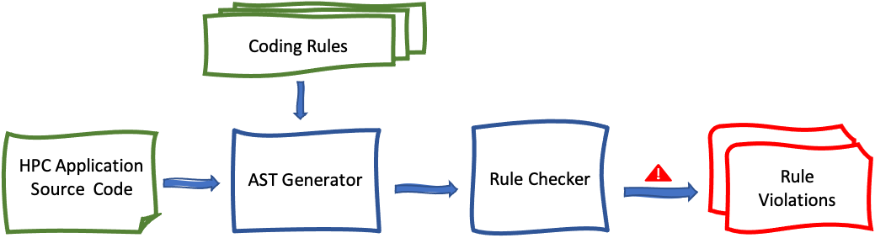
Checking for violations of the PETSc developer rules

Slide 54
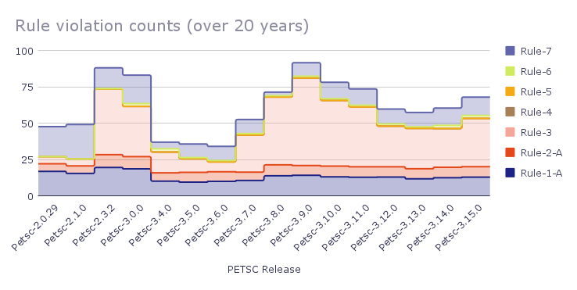
Example results for a subset of the PETSc rules

Slide 55
Capabilities summary
Type of Data/Analysis
Database
Examples
Repository Location
Git data: commits, changes (lines, files, etc.)
github.com/CAT-SDK/GremCat/
Github and Gilab issues and associated metadata
github.com/CAT-SDK/GremCat/
Code quality checkers (dynamic & static)
github.com/HPCL/code-analysis (dynamic)
github.com/HPCL/llvm-project/tree/xsdk-uo/clang-tools-extra/clang-tidy/petsc (static)
Mailing lists
Not publicly available yet, contact norris@cs.uoregon.edu
Mailing Lists

Slide 56
Summary
We introduced a flexible, efficient, and usable software framework for acquiring, storing, manipulating, and visualizing development-related data.
We demonstrated a few of its capabilities here; a growing number of analyses and tools are continuously being developed.
Contributions and/or requests welcome! https://github.com/CAT-SDK/GremCat
Acknowledgments: DOE ECP IDEAS Productivity Project
Carter Perkins, Bosco Ndemeye, Stephen Fickas, University of Oregon
Armando Acosta and Kanika Sood, California State University, Fullerton
Anshu Dubey and Lois Curfman McInnes, Argonne National Laboratory
Thank you!
ECP projects that may be present in examples in this presentation: Spack, LAMMPS, PETSc, Nek5000 E3SM, QMCPACK, QDPXX, LATTE NAMD, HYPRE, fast-export, Enzo, TAU2, xpress-apex, LATTE, NWChem

